Slide 1
Greco-Roman Through Renaissance Test Powerpoint

Slide 2
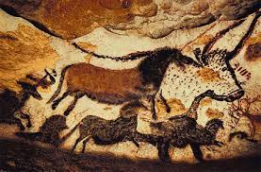
Lascaux Cave Paintings

Slide 3
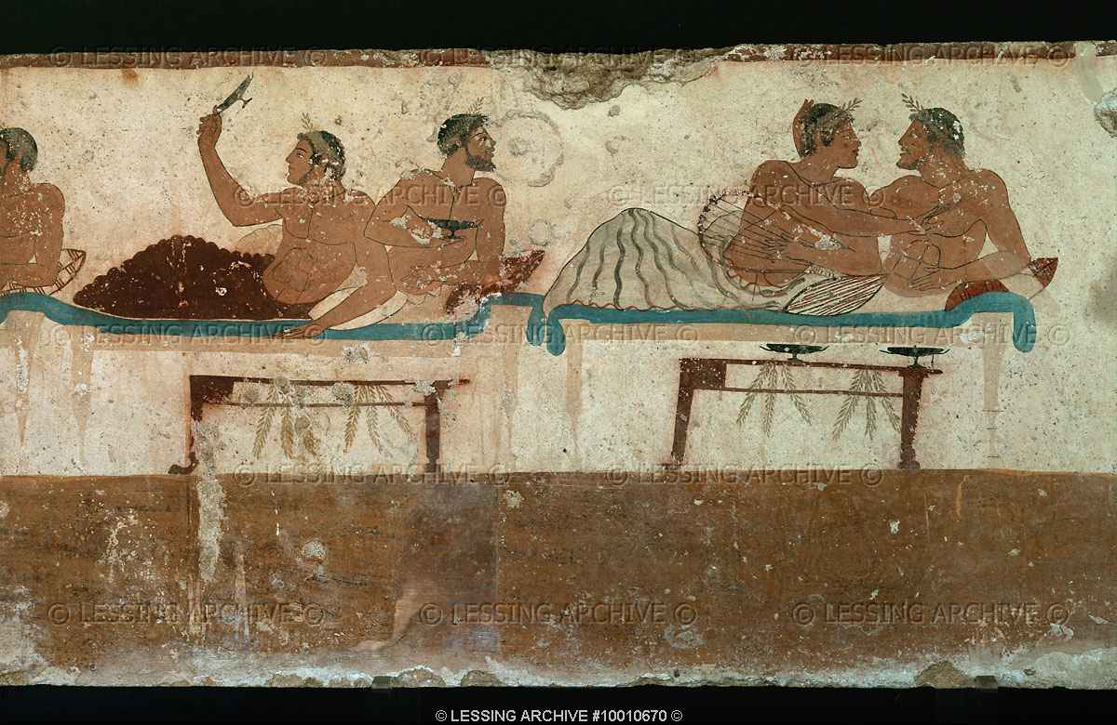
Tomb of the Diver

Slide 4
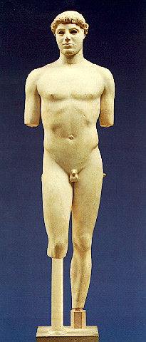
Kritos Boy

Slide 5
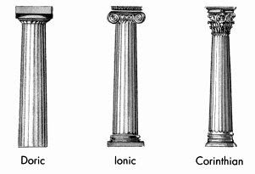
Diagram of Different Columns

Slide 6
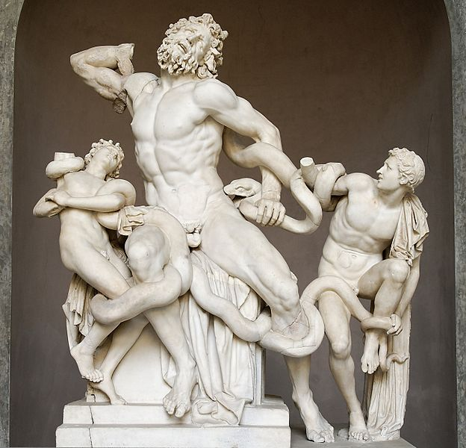
Lacoon and his Sons

Slide 7
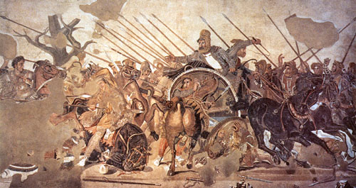
The Battle of Issus

Slide 8
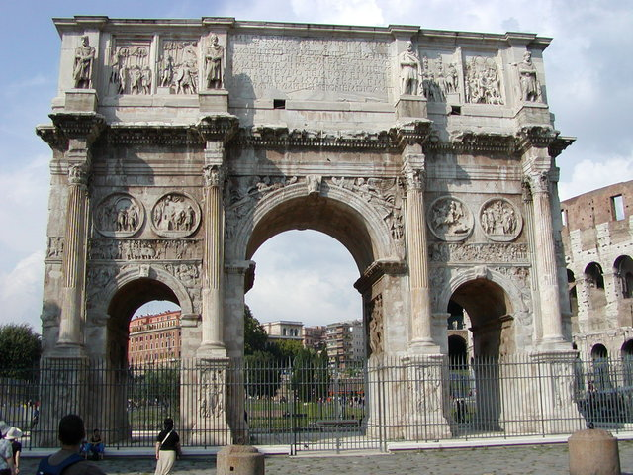
The Arch of Constantine- Rome, Italy

Slide 9
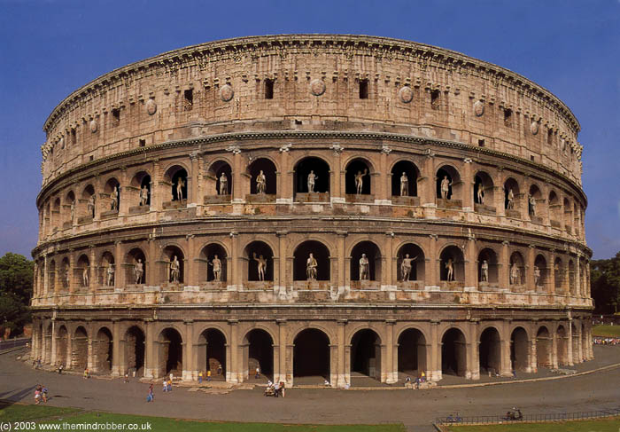
The Coliseum- Rome, Italy

Slide 10
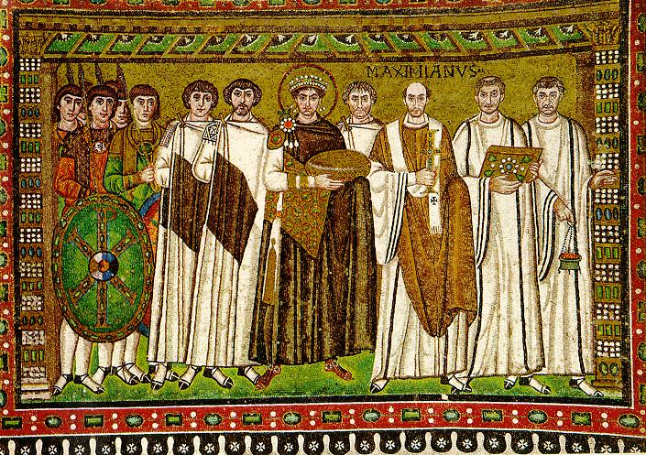
Emperor Justinian and Attendants 547 C.E.

Slide 11
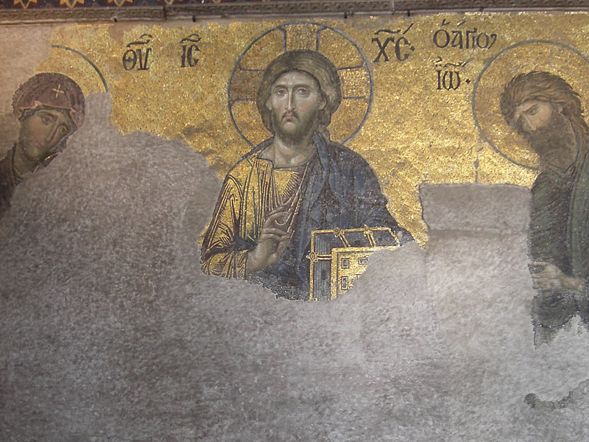
Christ Between the Virgin and Saint John the Baptist

Slide 12
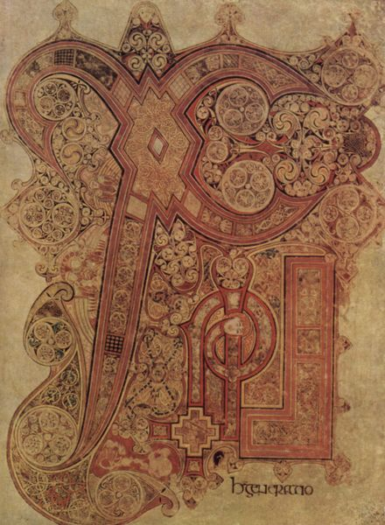
Lindisfarne Gospel Book circa 800 C.E.

Slide 13
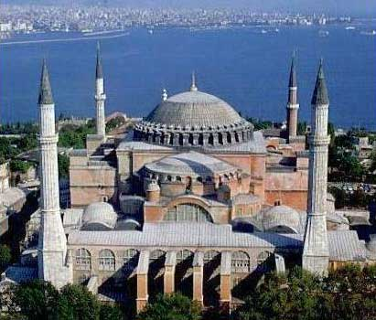
Hagia Sophia- Istanbul, Turkey

Slide 14
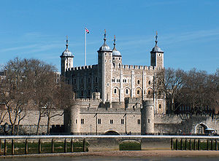
Tower of London 1080 C.E.

Slide 15
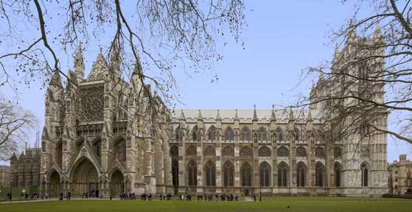
Westminster Abbey- London, England

Slide 16
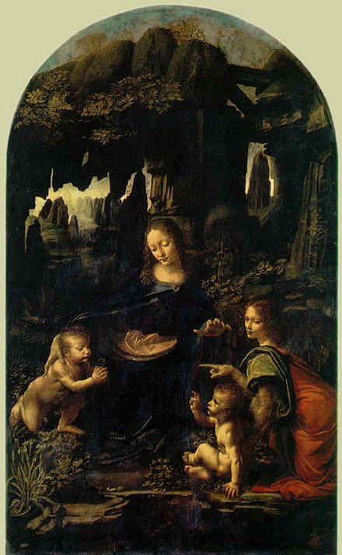
Da Vinci The Virgin of the Rocks 1485 C.E.

Slide 17
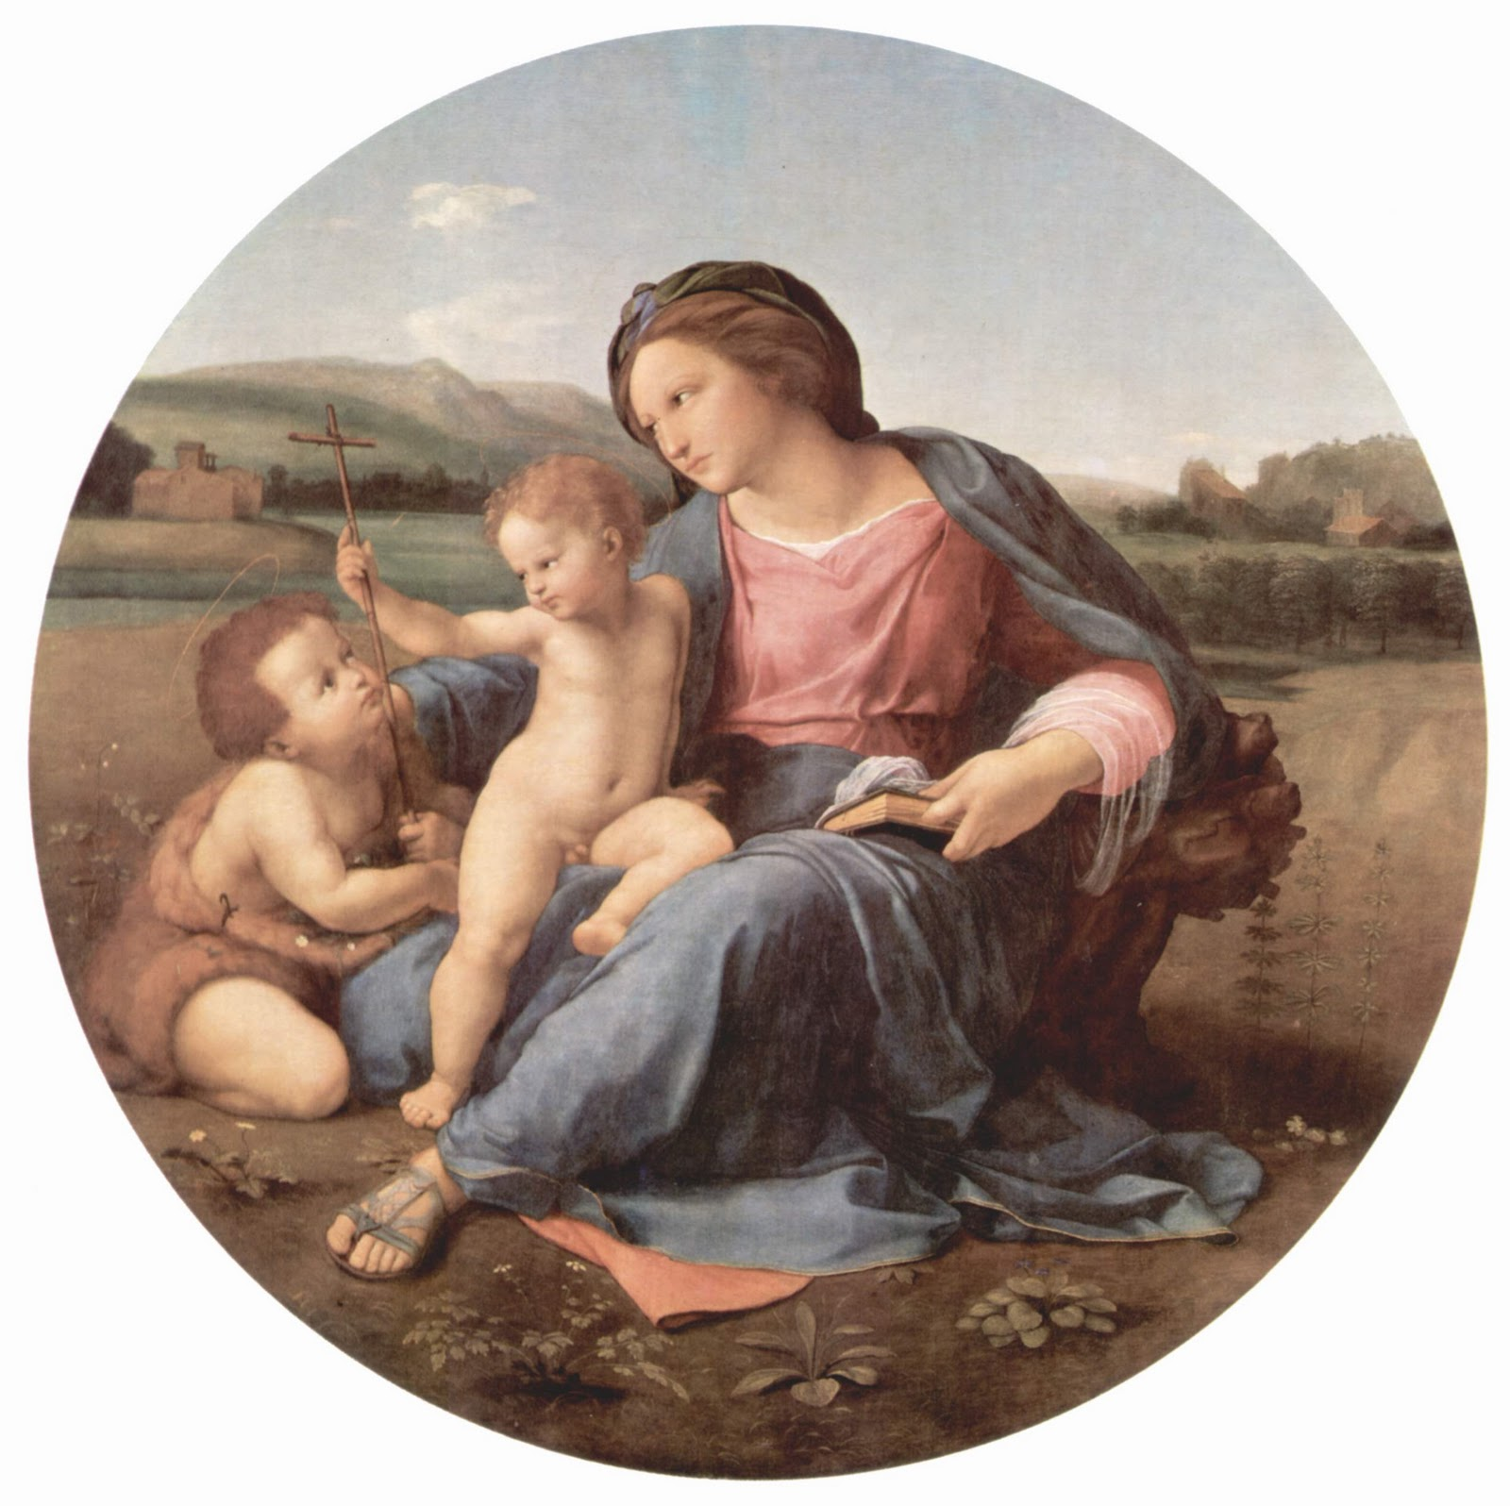
Raphael Virgin of the Rocks 1510 C.E.

Slide 18
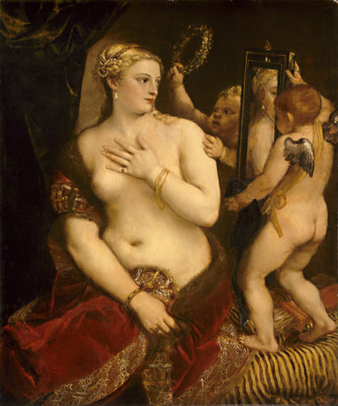
Titan Venus with a Mirror 1555 C.E.

Slide 19
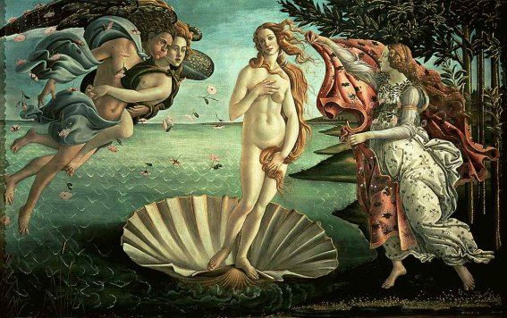
Botticelli The Birth of Venus 1482 C.E.

Slide 20
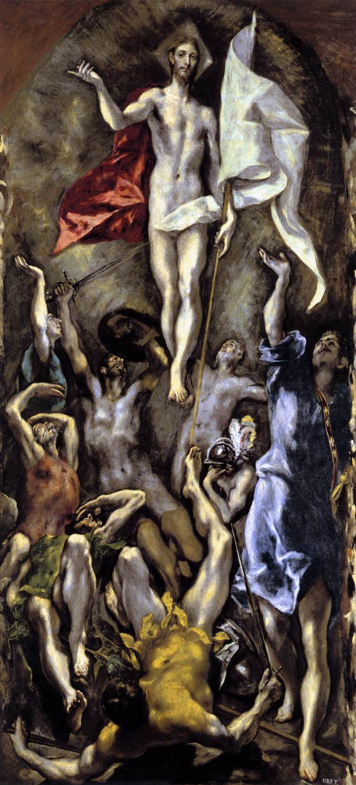
El Greco Resurrection 1597 C.E.

Slide 21
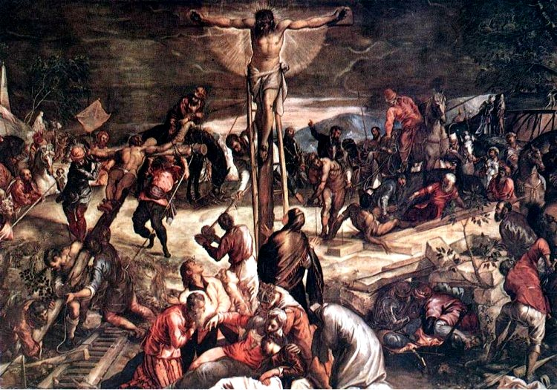
Tintoretto Crucifixion 1565 C.E.

Slide 22
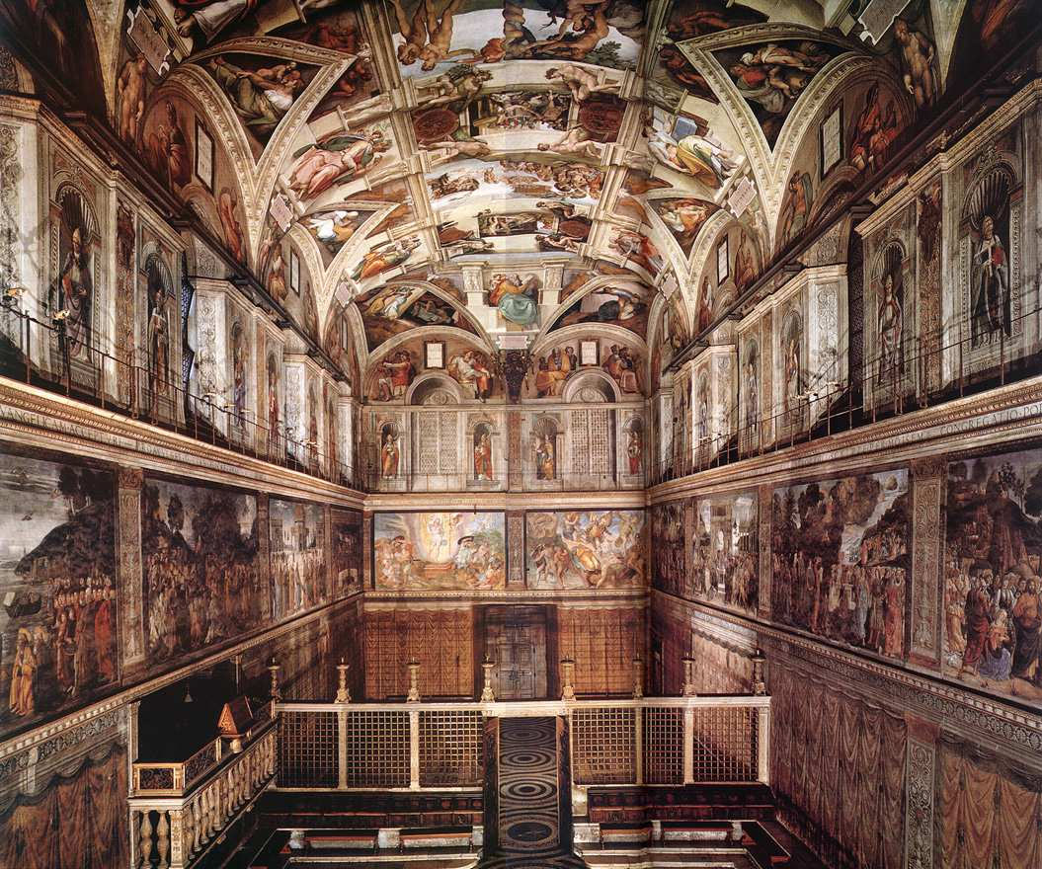
Michelangelo Sistine Chapel 1536 C.E.

Slide 23
Essay Slides
Possible Essay Slides are listed behind this particular slide.
There are 10 Possible Essay Slides. If these slides are not used as essays they may still appear on the test.

Slide 24
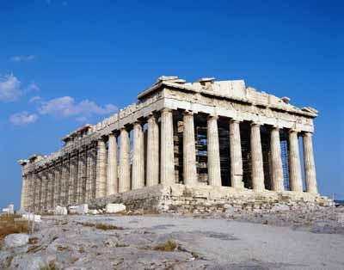
The Parthenon- Athens, Greece

Slide 25
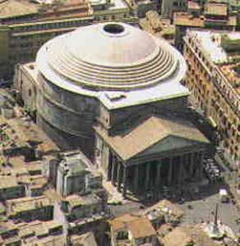
The Pantheon- Rome, Italy

Slide 26
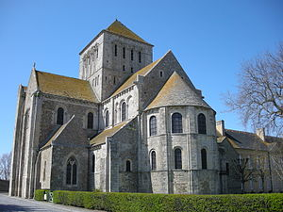
Lessay Abbey Circa 1100 C.E.

Slide 27
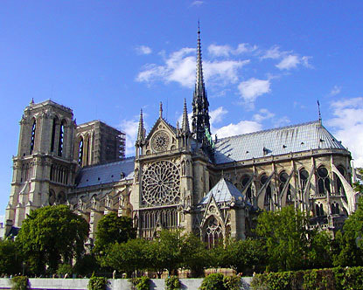
Notre Dame- Paris, France

Slide 28
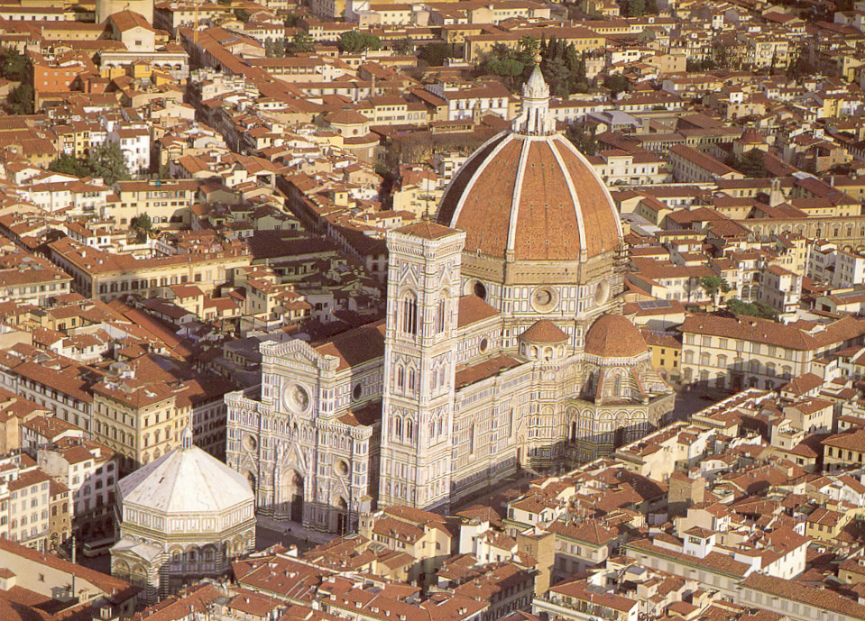
Filippo Brunelleschi Dome, Cathedral of Florence- Florence, Italy

Slide 29
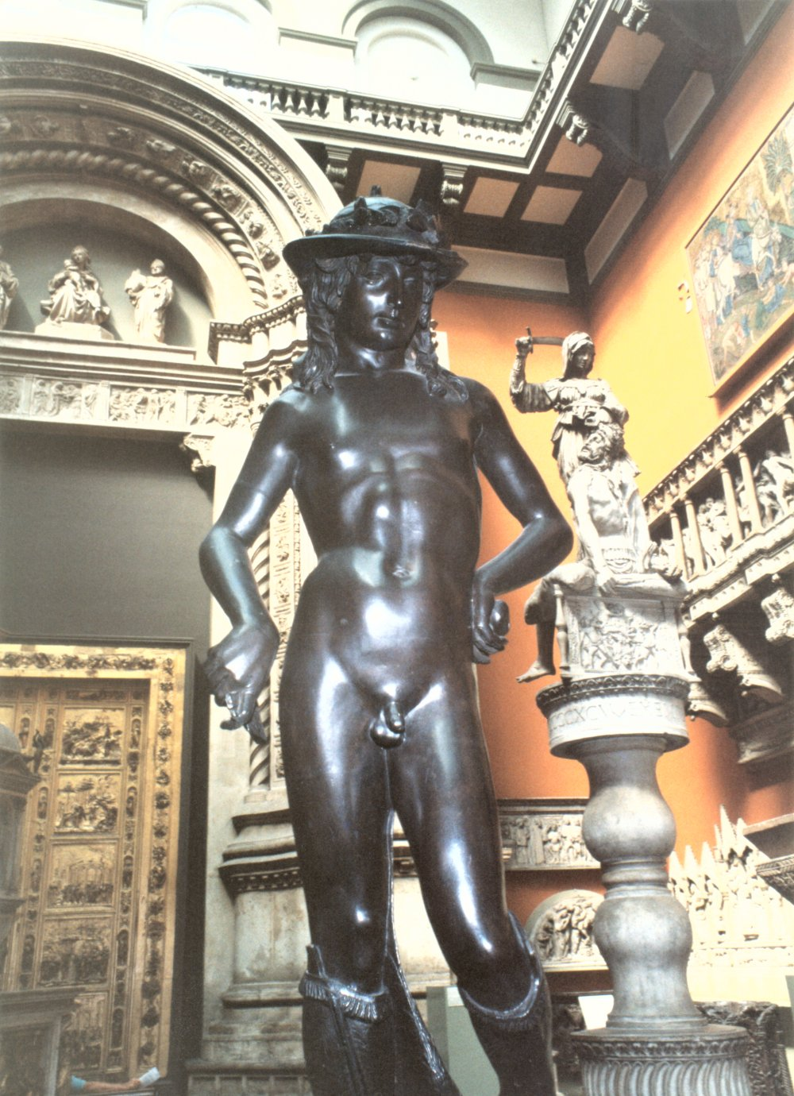
Donatello’s David 1430 C.E.

Slide 30
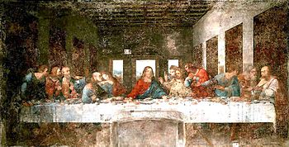
Da Vinci The Last Supper 1495 C.E.

Slide 31
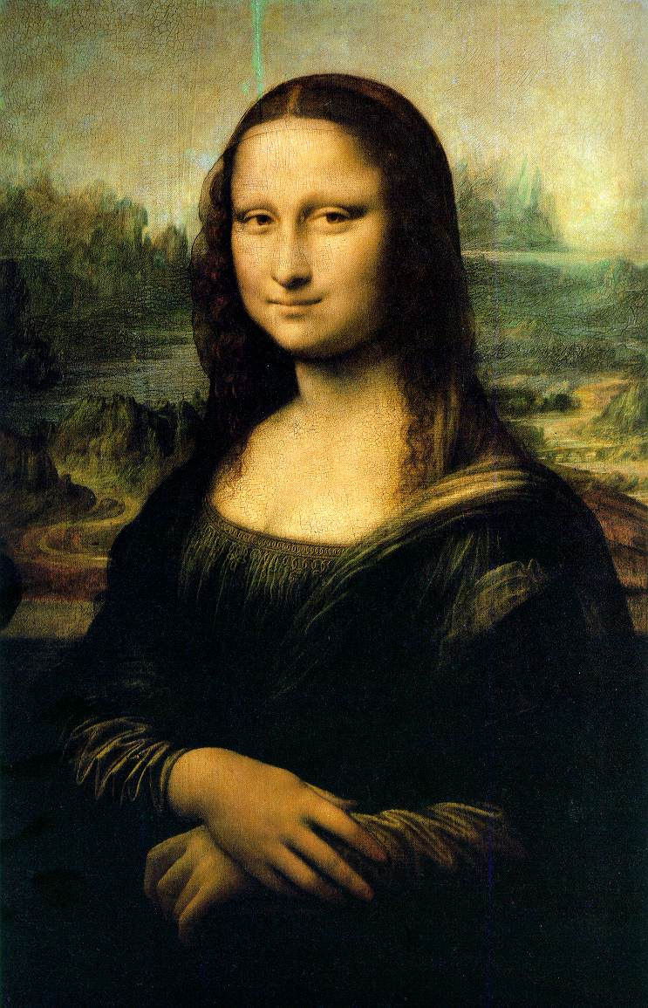
Da Vinci Last Supper 1503 C.E.

Slide 32
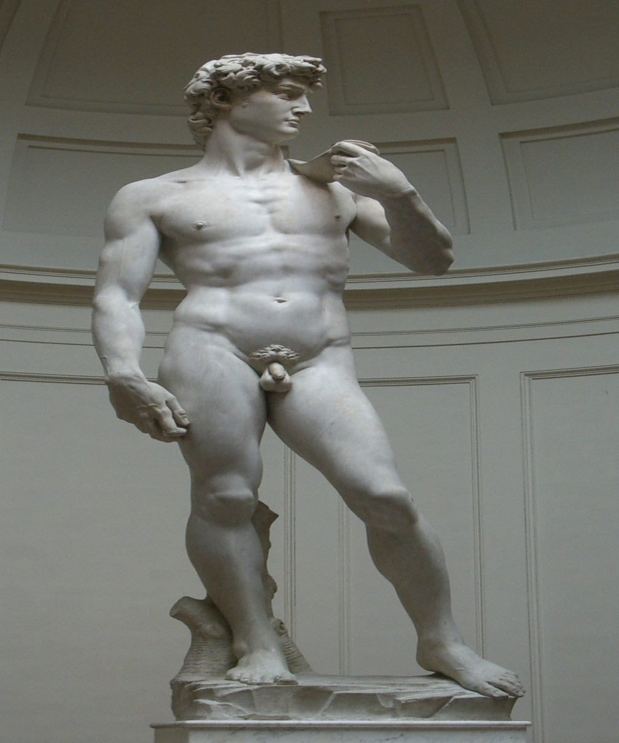
Michelangelo David 1501 C.E.

Slide 33
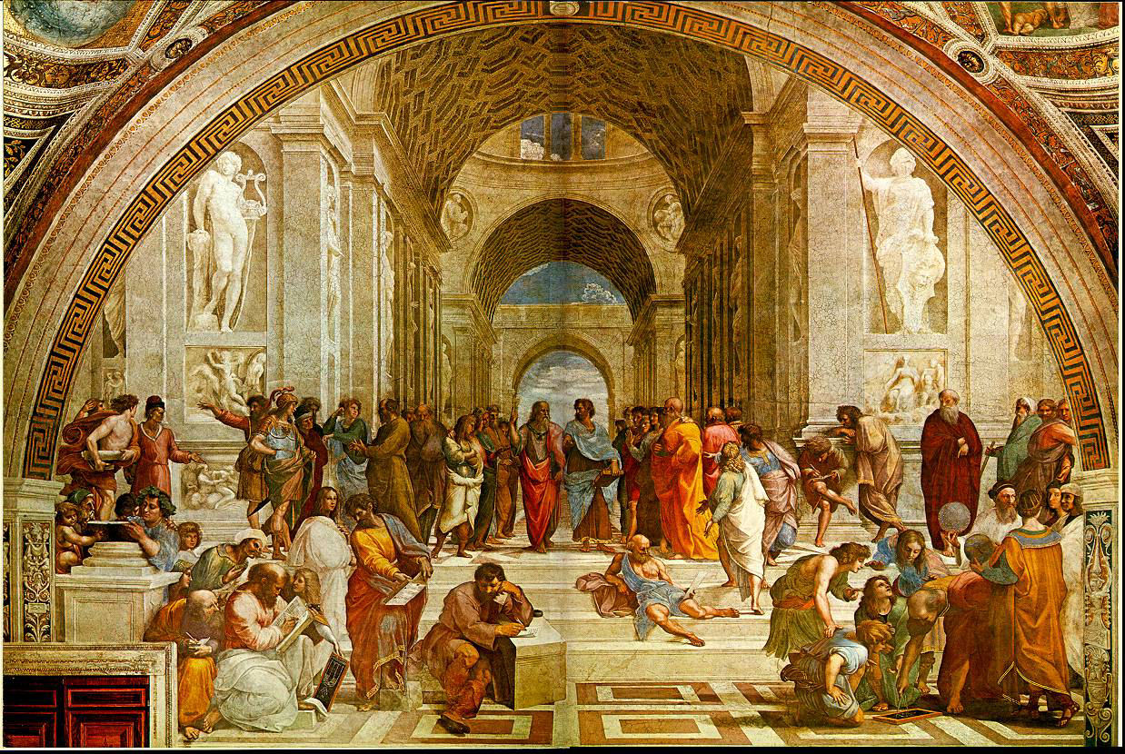
Raphael School of Athens 1510 C.E.

