Slide 1
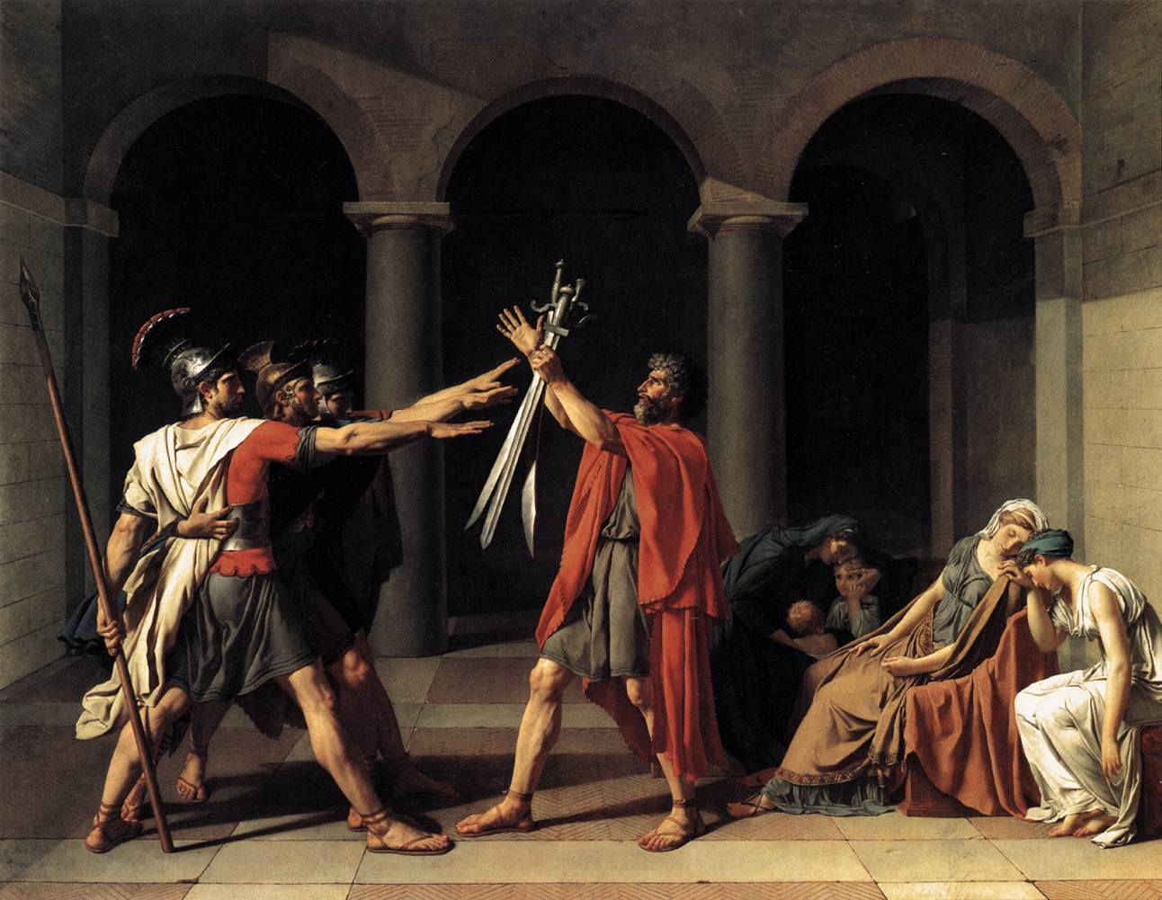
Jacques-Louis David (Oath of the Horatii, 1784)

Slide 2
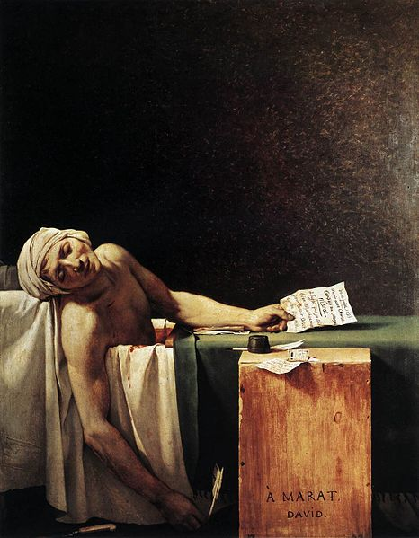
Jacques-Louis David (The Death of Marat, 1793)

Slide 3
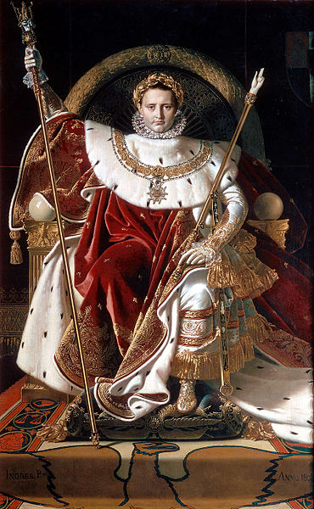
Jean-Auguste-Dominique Ingres (Napoleon on the Imperial Throne, 1806)

Slide 4
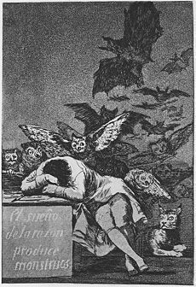
Francisco Goya (The Sleep of Reason Produces Monsters, 1794)

Slide 5
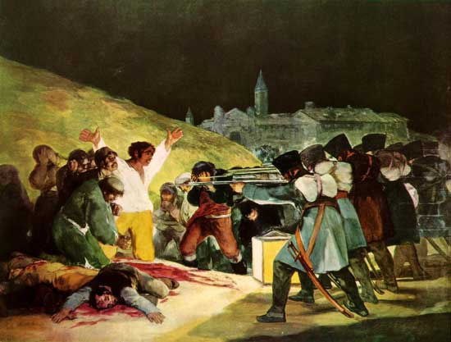
Francisco Goya (The Third of May, 1808)

Slide 6
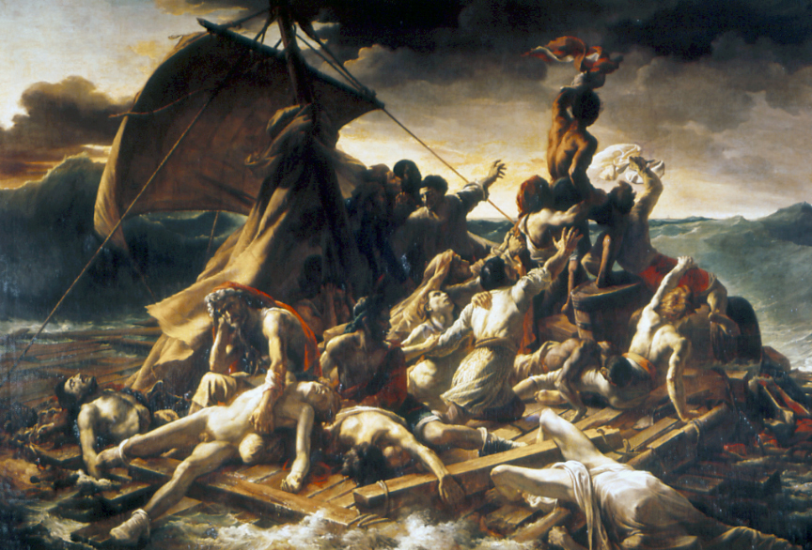
Theodore Gericault (The Raft of the Medusa, 1819)

Slide 7
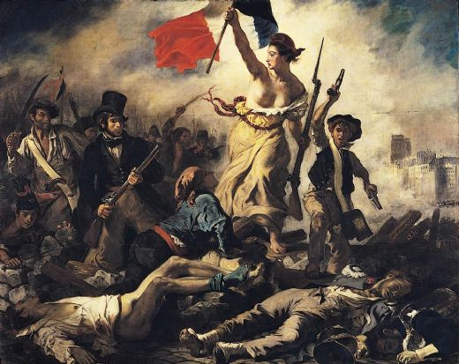
Eugene Delacroix (Liberty Leading the People, 1830)

Slide 8
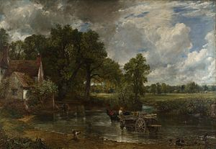
John Constable (The Hay Wain, 1821)

Slide 9
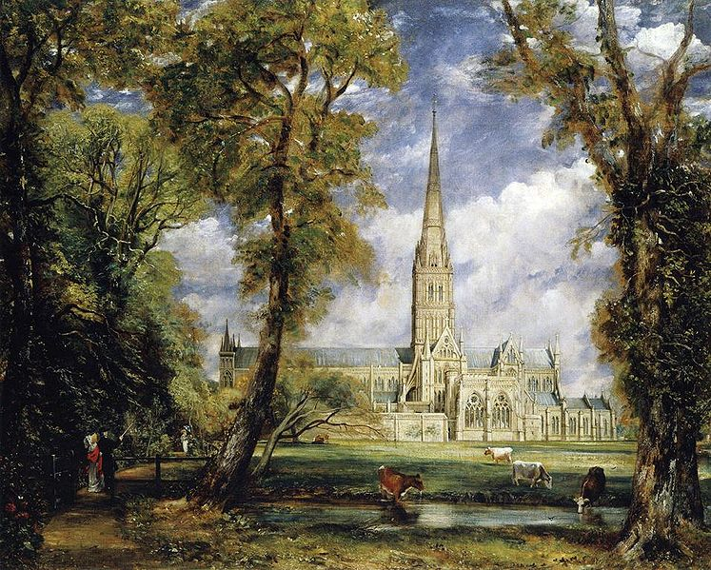
John Constable (Salisbury Cathedral at the Bishops Grounds, 1825)

Slide 10
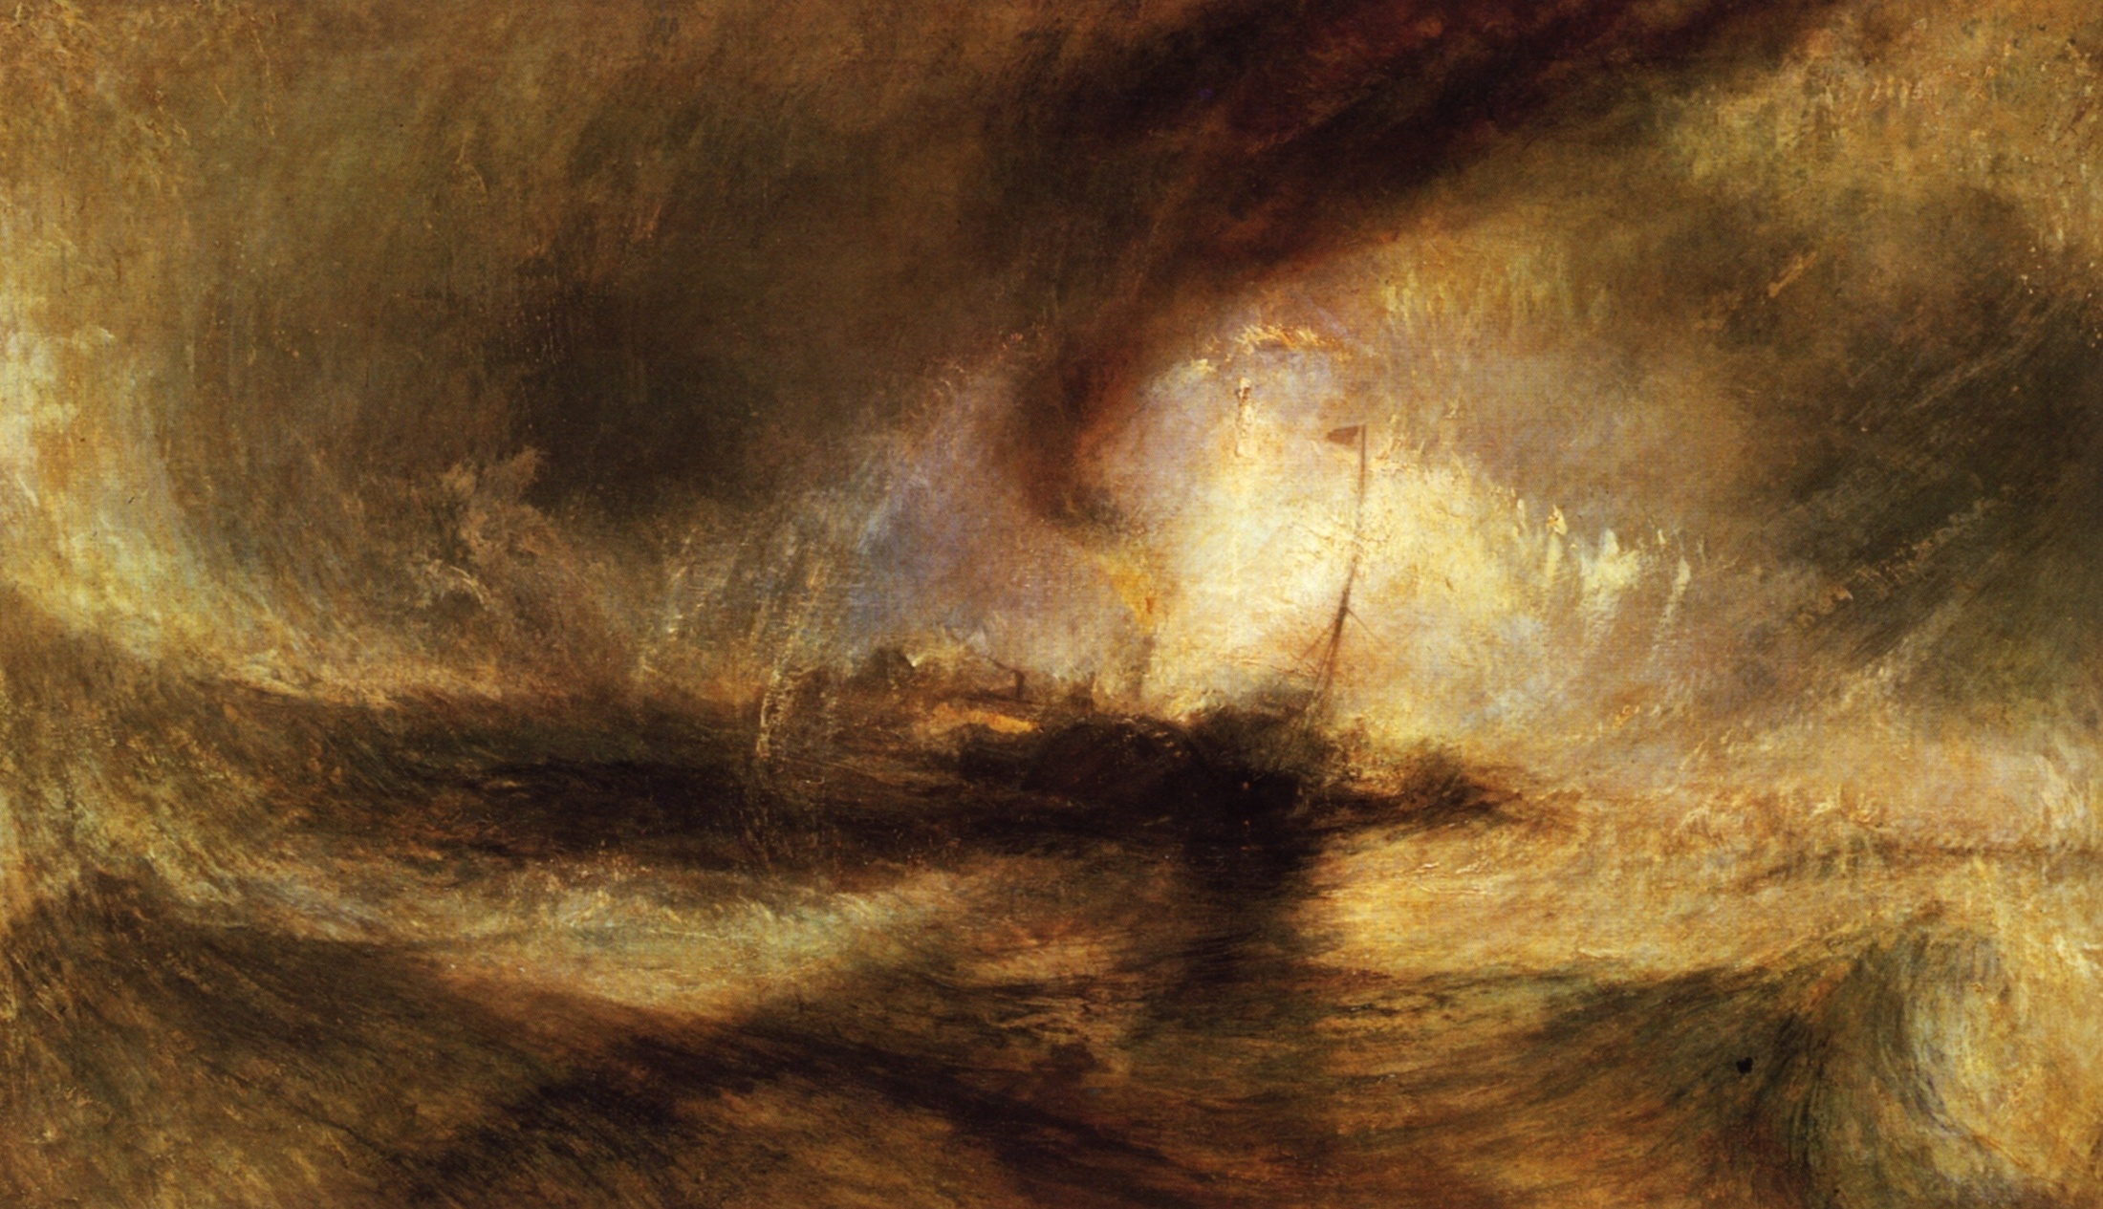
J.M.W. Turner (Snow Storm: Steamboat off of a Harbor’s Mouth, 1824)

Slide 11
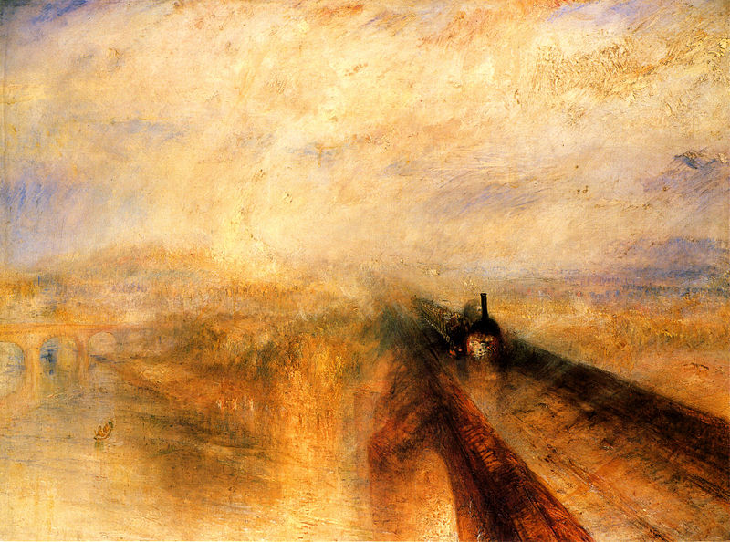
J.M.W. Turner (Rain, Speed, and Steam: The Great Western Railway, 1844)

Slide 12
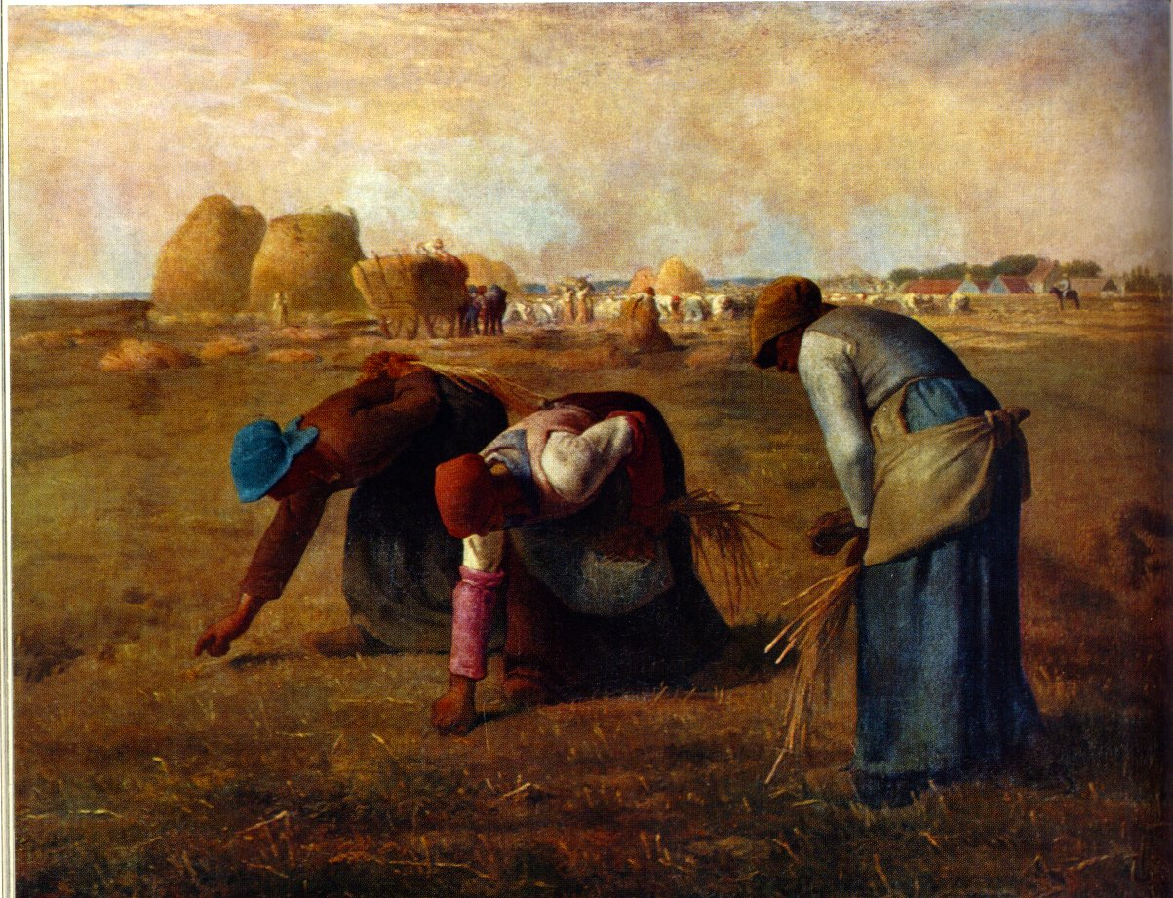
Jean Francois Millet (The Gleaners, 1857)

Slide 13
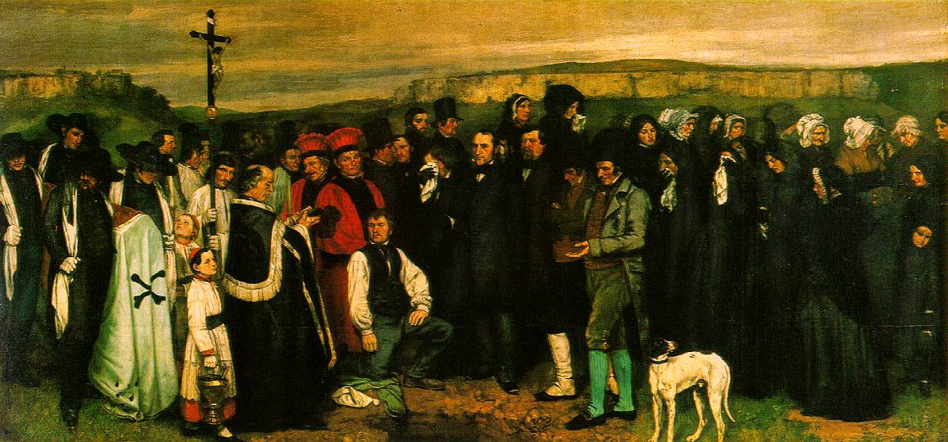
Gustave Courbet (Burial at Ornans, 1848)

Slide 14
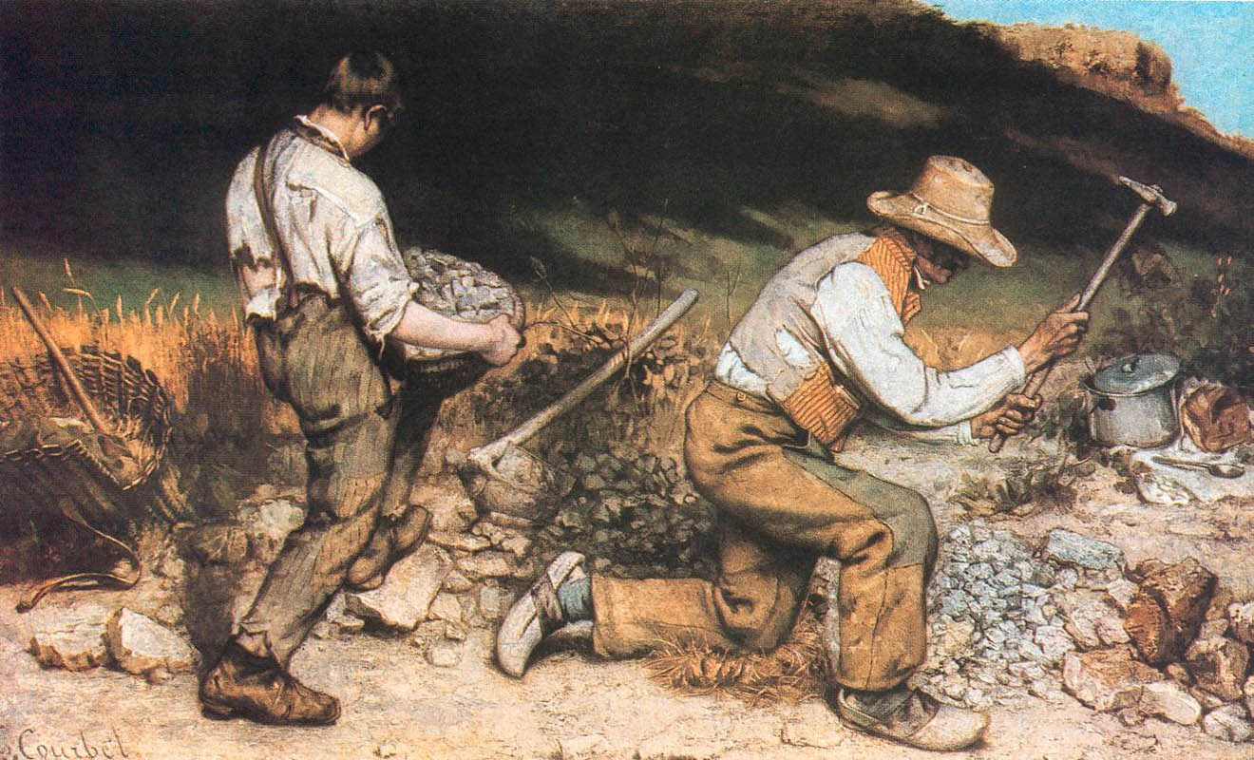
Gustave Courbet (The Stone Breakers, 1849)

Slide 15
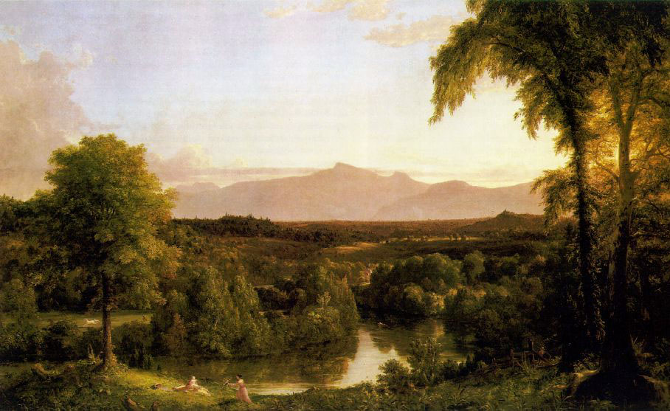
Thomas Cole (View of the Catskills, Early Autumn, 1837)

Slide 16
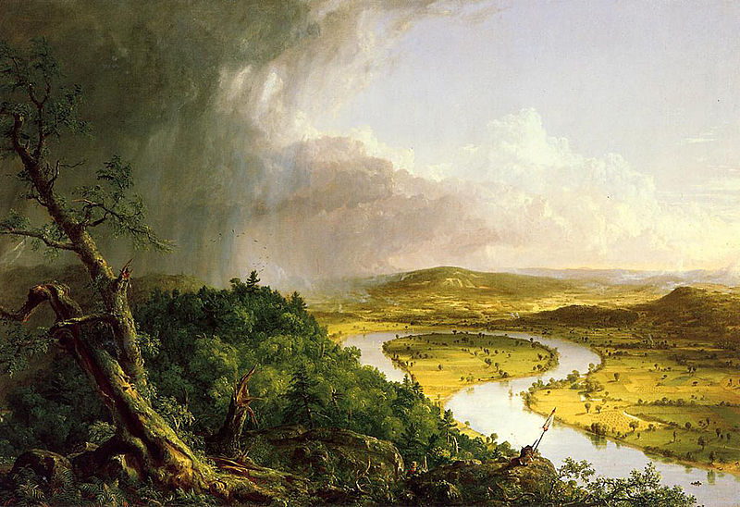
Thomas Cole (The Oxbow, 1836)

Slide 17
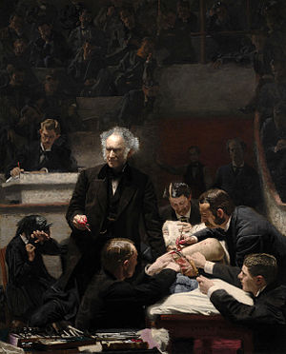
Thomas Eakins (The Gross Clinic, 1875)

Slide 18
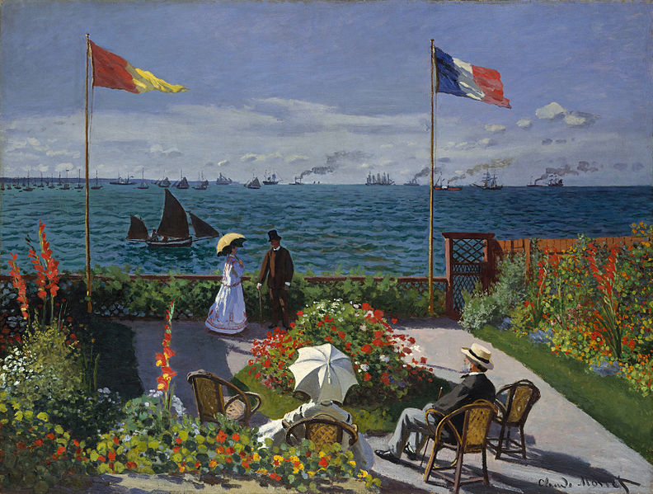
Claude Monet (Jardin a Sainte Adresse, 1867)

Slide 19
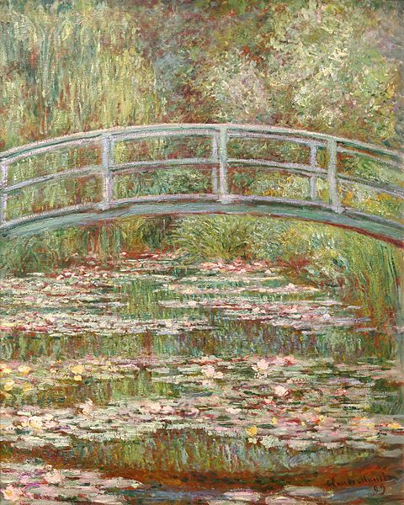
Claude Monet (Bridge over a Pond of Lilies, 1899)

Slide 20
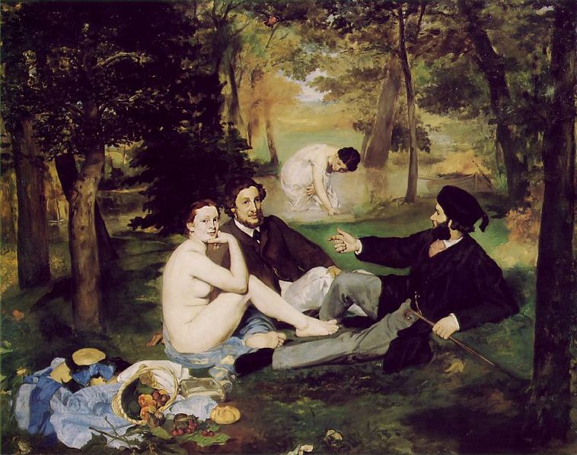
Edouard Manet (The Luncheon on the Grass, 1863),

Slide 21
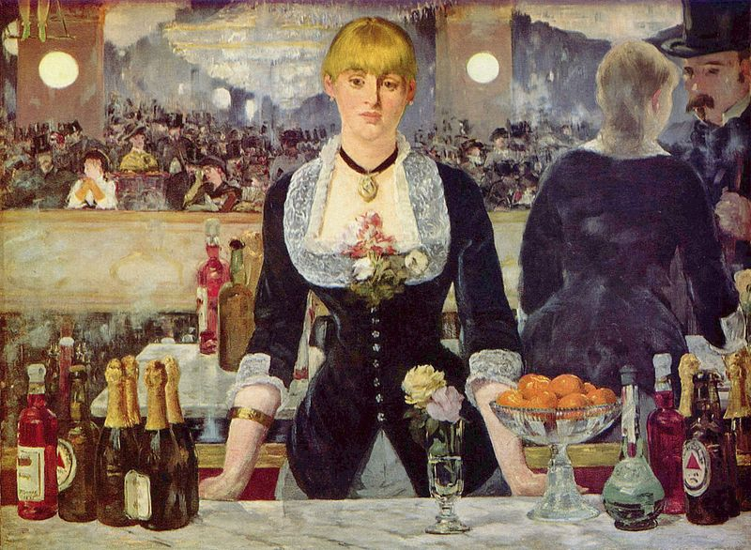
Edouard Manet (Le Bar aux Folies-Bergere ,1881)

Slide 22
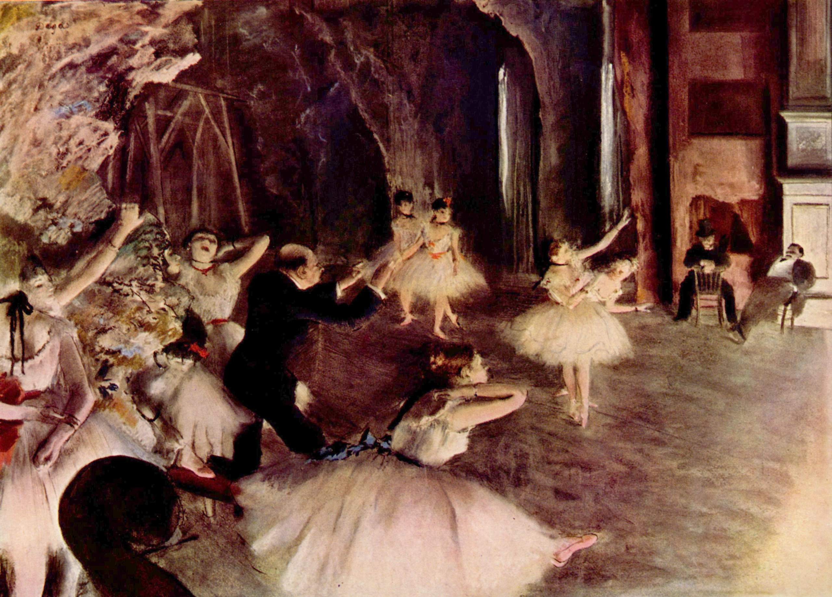
Edgar Degas (The Rehearsal on the Stage, 1874)

Slide 23
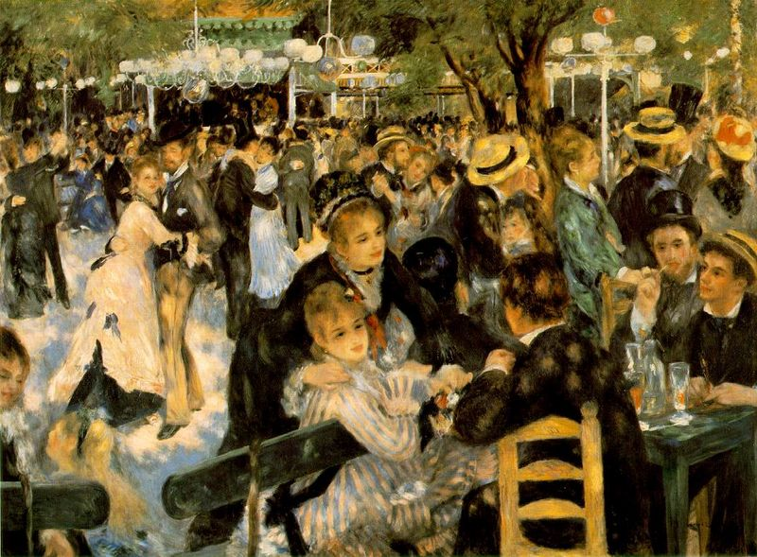
Pierre Auguste Renoir (Dance at the Moulin de la Galette Montmartre, 1876)

Slide 24
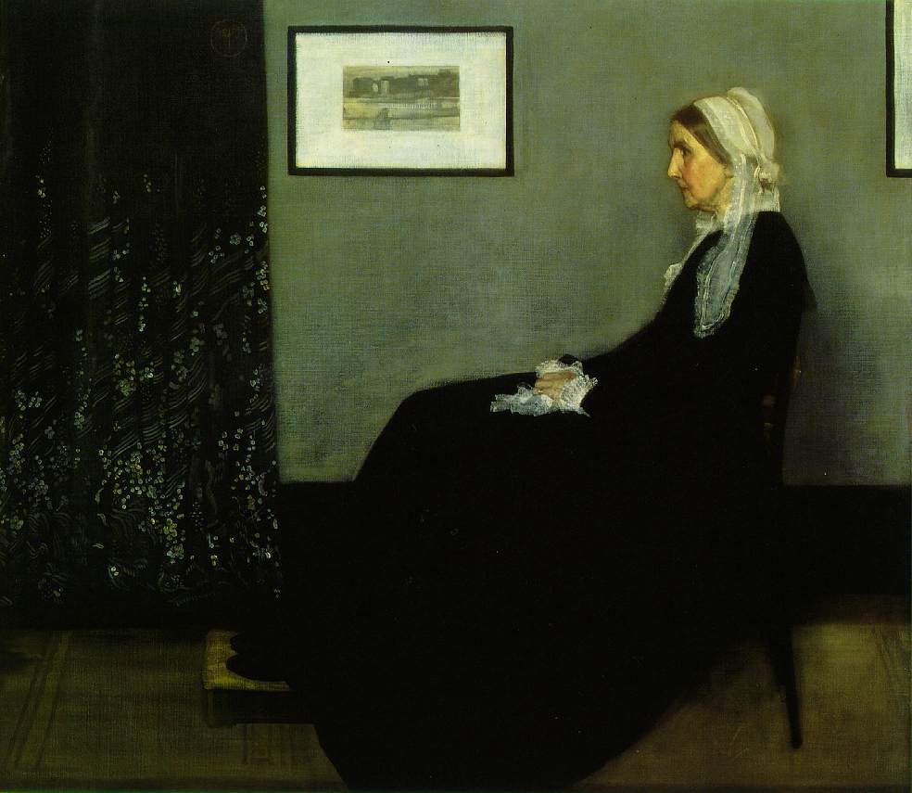
James McNeil Whistler (Arrangement in Gray and Black No. 1: The Artist’s Mother)

Slide 25
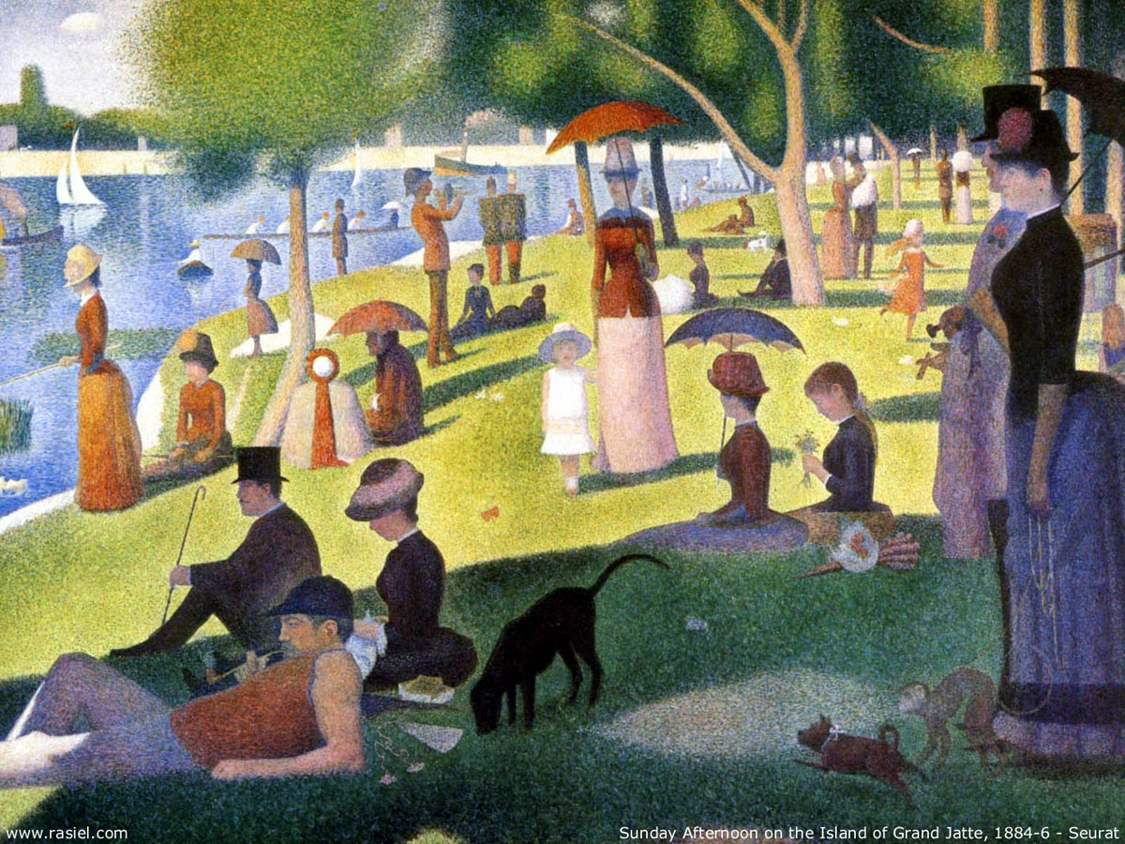
Georges Seurat (A Sunday on La Grande Jatte,1884)

Slide 26
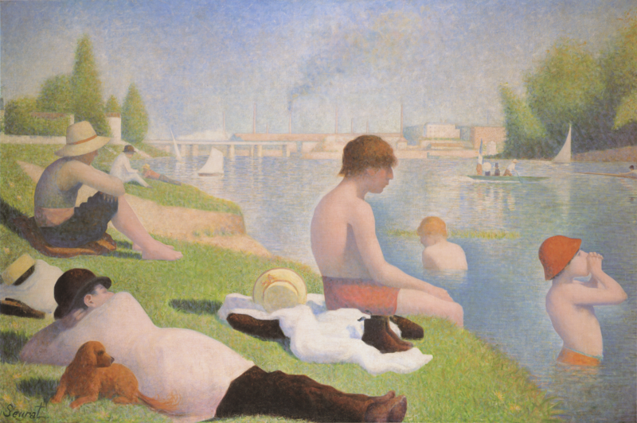
Georges Seurat (Bathers at Asineries, 1884)

Slide 27
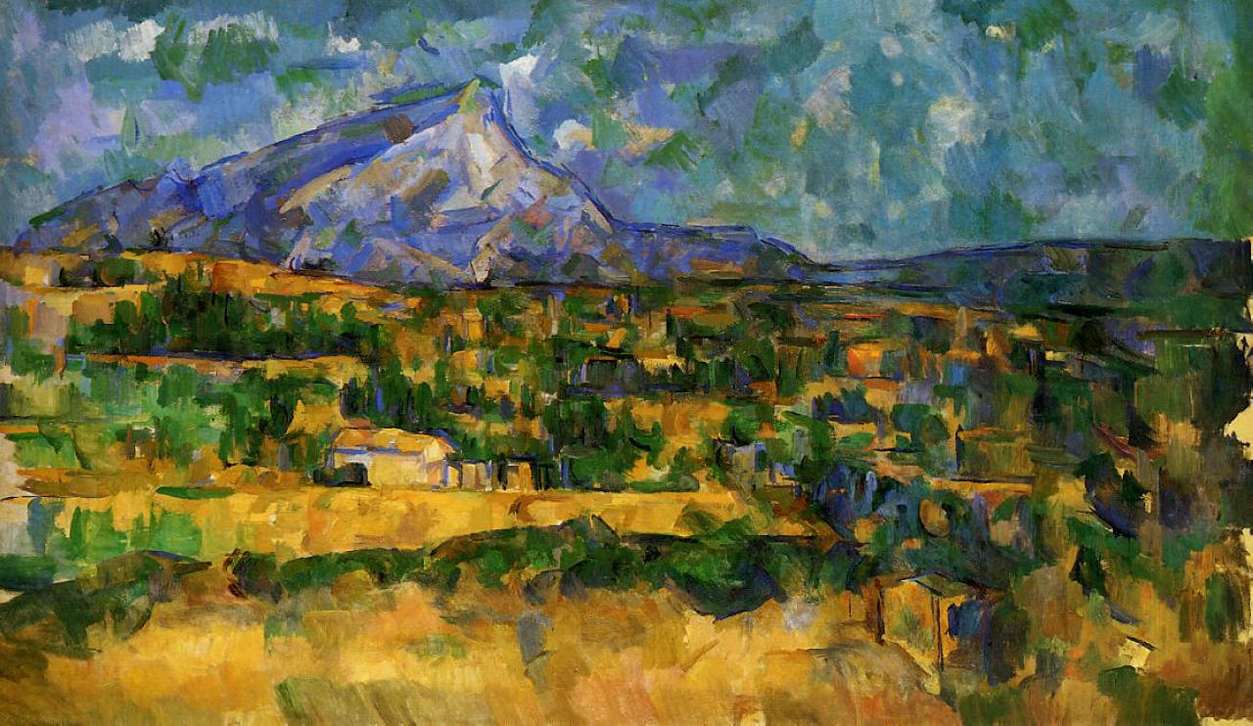
Paul Cezanne (Mount Sainte-Victoire, 1904)

Slide 28
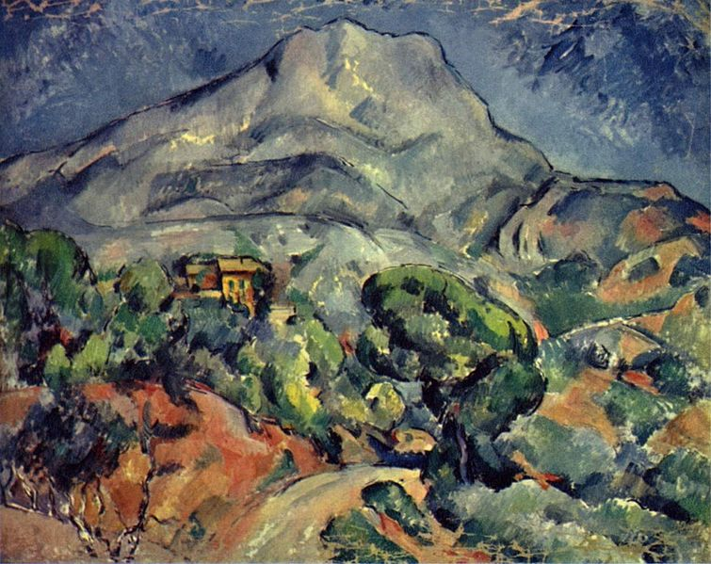
Paul Cezanne (The Road Before the Mountains, 1898)

Slide 29
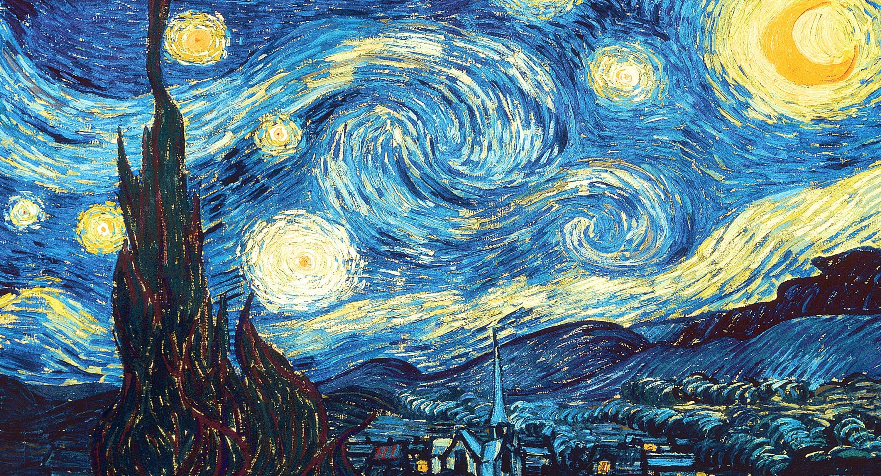
Vincent van Gogh (The Starry Night, 1889)

Slide 30
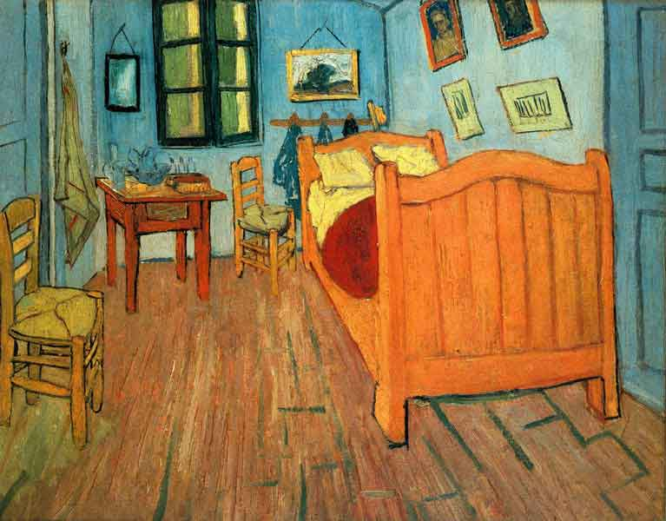
Vincent van Gogh (Bedroom in Arles, 1888)

Slide 31
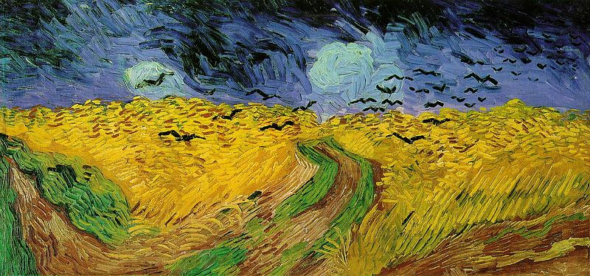
Vincent van Gogh (Wheatfield with Crows, 1890)

Slide 32
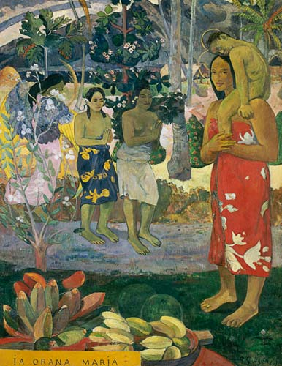
Paul Gauguin (La Orana Maria, 1891)

Slide 33
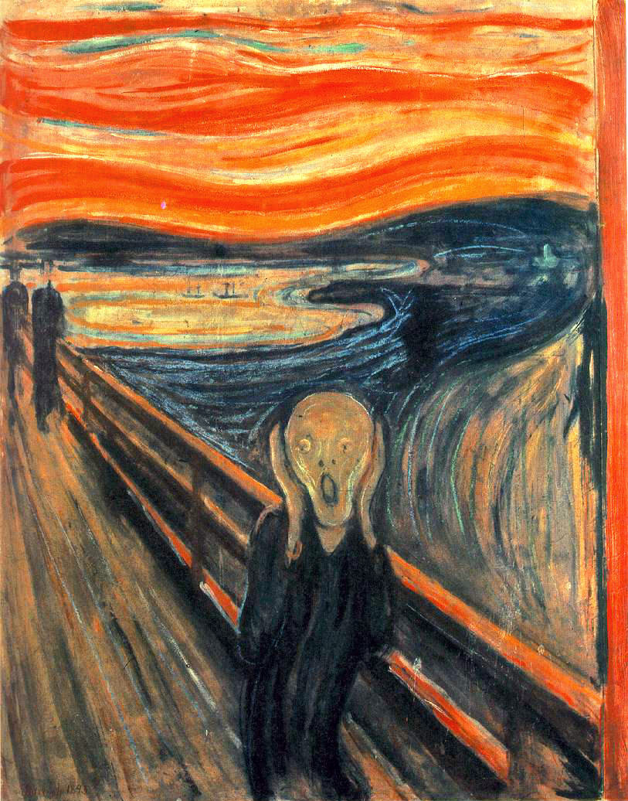
Edvard Munch (The Cry, 1893)

Slide 34
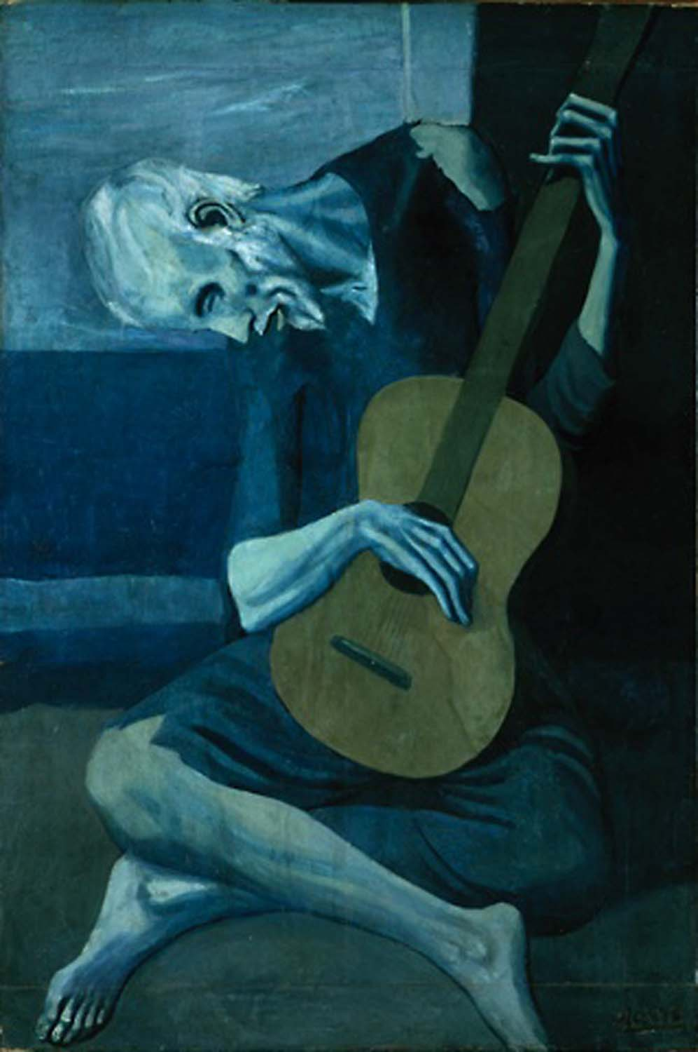
Pablo Picasso (The Old Guitarist, 1903)

Slide 35
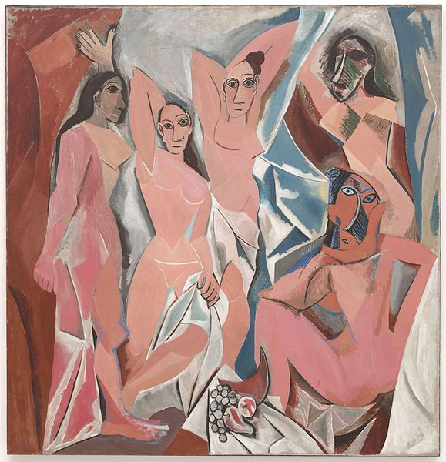
Pablo Picasso (Les Demoiselles d'Avignon, 1907)

Slide 36
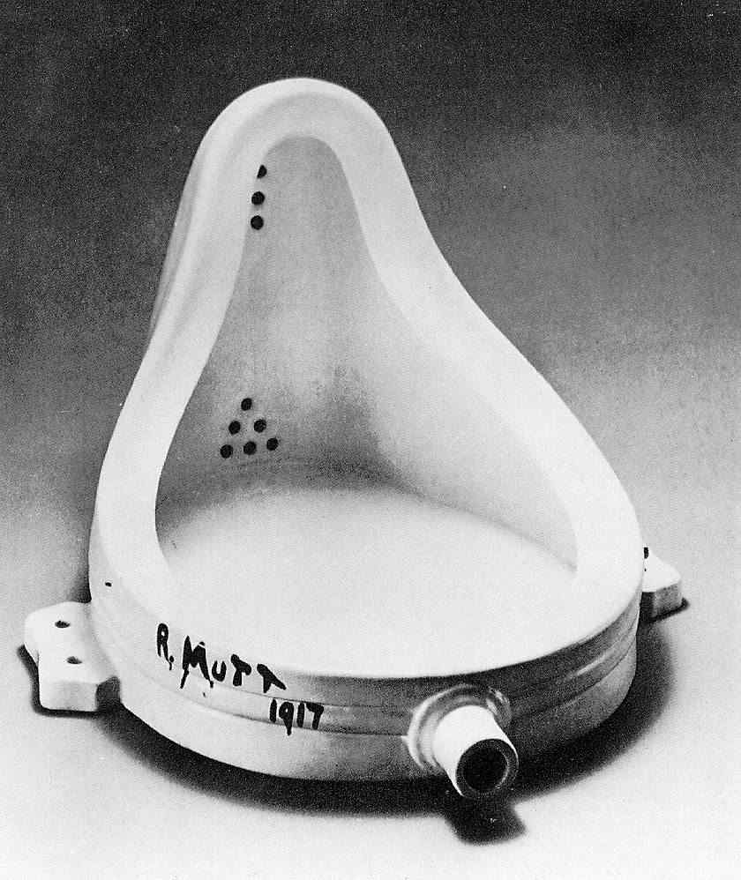
Marcel Duchamp (Fountain, 1917)

