Slide 1
Breeding Bird Census:
Hamburg Area SD Environmental Science Class
at
Hawk Mountain Sanctuary

Slide 2
Top 20 Songbird Species
Ovenbird
Red-eyed Vireo
Scarlet Tanager
Common Yellowthroat
Wood Thrush
Hermit Thrush
Eastern Wood-Pewee
Black-and-White Warbler
Tufted Titmouse
Blue Jay
Acadian Flycatcher
Great-crested Flycatcher
Downy Woodpecker
Pileated Woodpecker
Black-capped Chickadee
Indigo Bunting
White-breasted Nuthatch
Yellow-billed Cuckoo
Black-throated Green Warbler
Rose-breasted Grosbeak

Slide 3
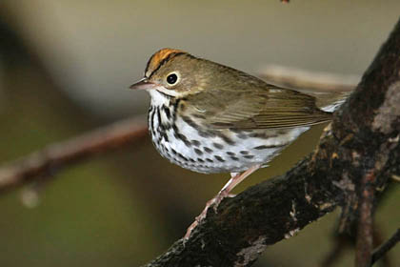
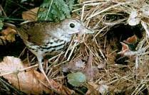
Ovenbird OVEN
Week 1
Song:
The ovenbird's song sounds like teacher-teacher-teacher
http://www.allaboutbirds.org/guide/Ovenbird/sounds
Habitat:
Ovenbirds breed in closed-canopy forests, particularly deciduous and mixed deciduous-coniferous woods.
Ovenbirds spend much of their time foraging on the ground.
Field Marks:
Ovenbirds are olive-green above and spotted below, with bold black-and-orange crown stripes. It has a white eye ring. Ovenbirds have pink legs.
Often holds its tail upward.

Slide 4
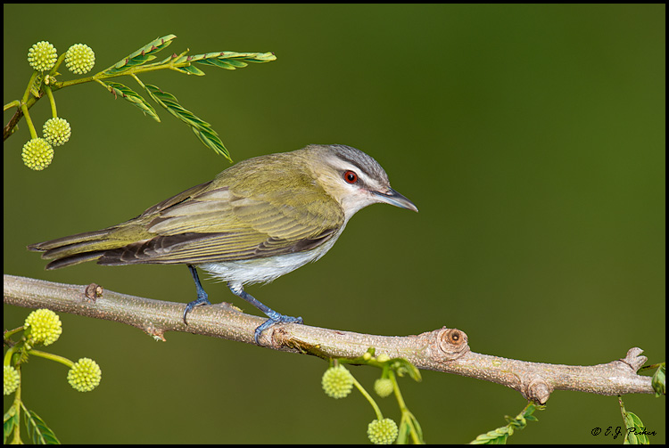
Red-eyed Vireo REVI
Week 1
Song:
Males sing incessantly—sometimes more than 20,000 per day by a single male! They can be heard even during the hottest part of the day.
The song sounds like its saying “where are you?” and then answering “here I am” over and over again.
http://www.allaboutbirds.org/guide/Red-eyed_Vireo/sounds
Habitat:
Large expanses of deciduous forest are Red-eyed Vireo habitat during the breeding season.
They forage in deciduous canopies where they can be difficult to find among the green leaves.
Field Marks:
Red-eyed Vireos are olive-green above and clean white below with a strong head pattern: a gray crown and white eyebrow stripe bordered above and below by blackish lines. Adults have red eyes.
Bill has a small hook at the tip.

Slide 5
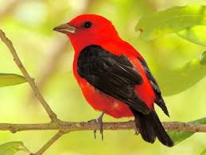
Scarlet Tanager SCTA
Week 1
Song:
The male Scarlet Tanager sings a burry series of 4–5 chirruping phrases. Many people liken it to the sound of a robin with a sore throat.
The most common call sounds like chick-breee or chip-burrr.
http://www.allaboutbirds.org/guide/Scarlet_Tanager/sounds
Habitat:
Scarlet Tanagers breed in deciduous and mixed deciduous-evergreen forests. They are somewhat sensitive to habitat fragmentation, so look for them in large, undisturbed tracts of forest.
They spend much of their time feeding among the wide leaves of deciduous trees in the forest canopy, where they are hard to see.
Field Marks:
In spring and summer, adult males are an unmistakable, brilliant red with black wings and tails. Females and fall immature birds are olive-yellow with darker olive wings and tails.

Slide 6
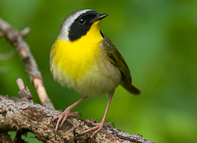
Common Yellowthroat COYE
Week 1
Song:
Males sing a very distinctive, rolling wichety-wichety-wichety song.
They are very vocal birds.
http://www.allaboutbirds.org/guide/Common_Yellowthroat/sounds
Habitat:
Yellowthroats live in open areas with thick, low vegetation, ranging from marsh to grassland to open pine forest.
Common Yellowthroats spend much of their time foraging low to the ground in dense thickets and fields, searching for small insects and spiders.
Field Marks:
Adult males are bright yellow below, with a sharp black face mask and olive upperparts. A thin whitish line sets off the black mask from the head and neck. Females are a plain olive brown, usually with yellow brightening the throat and under the tail.

Slide 7
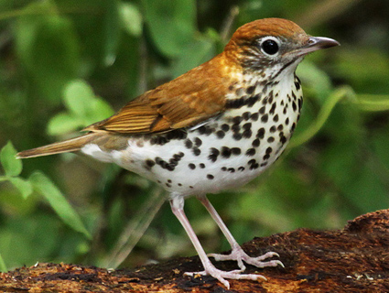
Wood Thrush WOTH
Week 1
Song:
http://www.allaboutbirds.org/guide/Wood_Thrush/sounds
The Wood Thrush's easily recognized, flute-like tut, tut, oh-lay-oh-leeeee is actually only the middle phrase of a three-part song. It learns the phrase from other Wood Thrushes and sings several variants.
Habitat:
The Wood Thrush breeds in deciduous and mixed forests where there are large trees, moderate understory, shade, and abundant leaf litter for foraging.
This bird hops through leaf litter on the forest floor, probing for insects.
Field Marks:
Wood Thrushes are reddish-brown above and white with bold black spots on their underparts. Juveniles show a somewhat muted version of the same pattern. All have a bold, white eye ring.

Slide 8
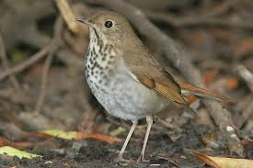
Hermit Thrush HETH
Week 2
Song:
The song begins with a sustained whistle and ends with softer, echo-like tones, described as oh, holy holy, ah, purity purity eeh, sweetly sweetly.
http://www.allaboutbirds.org/guide/Hermit_Thrush/sounds
Habitat:
Hermit Thrushes can be found in forest understories, especially around edges or openings.
Hermit Thrushes hop and scrape in leaf litter while foraging. They perch low to the ground on fallen logs and shrubs, often wandering into open areas such as forest clearings or trails.
Field Marks:
The Hermit Thrush is brown on the head and back, with a reddish tail. The underparts are pale with distinct spots on the throat and smudged spots on the breast. With a close look you may see a thin pale eye ring.

Slide 9
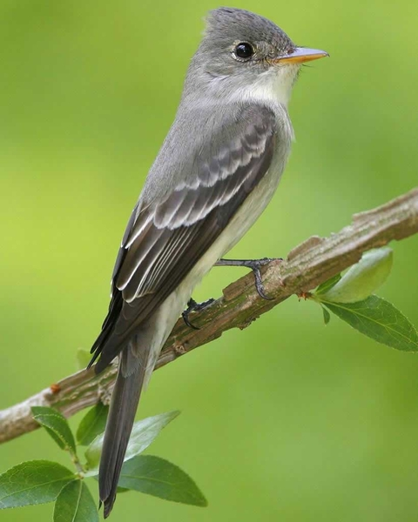
Eastern Wood- Pewee EWPE
Week 2
Song:
Eastern Wood-Pewees sing a distinctive, slurred pee-a-wee call from exposed perches.
http://www.allaboutbirds.org/guide/Eastern_Wood-pewee/sounds
Habitat:
Eastern Wood-Pewees are most common in deciduous forest and woodland, but you may find them in nearly any forested habitat, even smaller woodlots as long as it is fairly open.
They are sit-and-wait predators that fly out from a perch after insects and return to the same or a nearby perch. They often perch high in trees, generally in fairly exposed places providing good viewpoints.
Field Marks:
Eastern Wood-Pewees are olive-gray birds with dark wings. The sides of the breast are dark with an off-white throat and belly. Adults have thin, white wingbars.

Slide 10
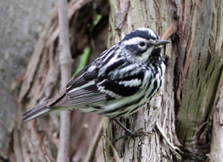
Black-and-White Warbler BAWW
Week 2
Song:
Often described as a squeaky wheel.
Wee-zee wee-zee wee-zee
http://www.allaboutbirds.org/guide/black-and-white_warbler/sounds
Habitat:
Deciduous forest and mixed forest are the preferred summer habitats of Black-and-white Warblers, usually with trees of mixed ages that provide a variety of foraging substrates.
The birds forage for hidden insects in the bark of trees by creeping up, down, and around branches and trunks. Despite their arboreal foraging habits, they nest on the ground at the bases of trees.
Field Marks:
These birds are boldly striped in black and white. Their black wings are highlighted by two wide, white wing bars.

Slide 11
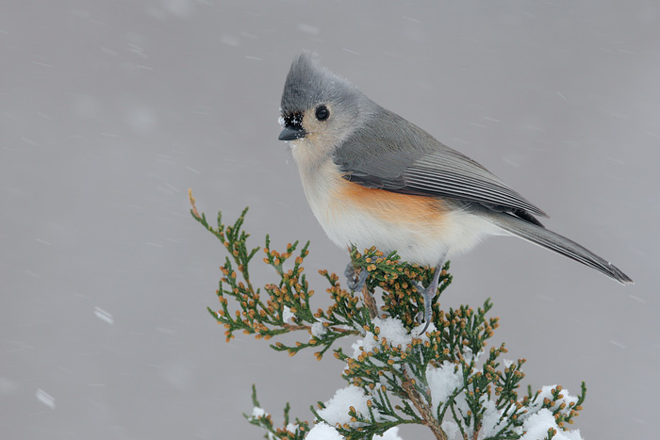
Tufted Titmouse TUTI
Week 2
Song:
The song is a fast-repeated, clear whistle: peter-peter-peter.
http://www.allaboutbirds.org/guide/tufted_titmouse/sounds
Habitat:
Found in woodlands below 2,000 feet elevation, including deciduous and evergreen forests. Tufted Titmice are also common visitors at feeders and can be found in backyards, parks, and orchards.
Tufted Titmice are acrobatic foragers.
Field Marks:
Soft silvery gray above and white below, with a rusty or peach-colored wash down the flanks. The pointed crest and stout bill help identify titmice. Large eye as well.

Slide 12
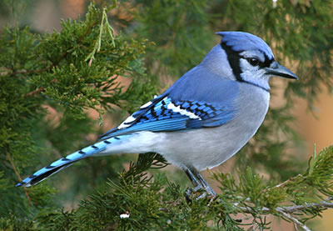
Blue Jay BLJA
Week 2
Song:
Blue Jays make a large variety of calls.
The most often heard is a loud jeer. It also makes clear whistled notes and gurgling sounds. Blue Jays frequently mimic hawks, especially Red-shouldered Hawks.
http://www.allaboutbirds.org/guide/blue_jay/sounds
Habitat:
Blue Jays are birds of forest edges. A favorite food is acorns, and they are often found near oaks, in forests, woodlots, towns, cities, parks.
Field Marks:
Large crested songbird with broad, rounded tail. White or light gray underneath, various shades of blue, black, and white above.

Slide 13
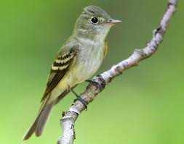
Acadian Flycatcher ACFL
Week 3
Song:
Song sounds like "peet-sah" or "flee-sick.“
http://www.allaboutbirds.org/guide/acadian_flycatcher/sounds
Habitat:
Breeds in mature forest, especially deciduous woods, along streams, in ravines, and in swamps.
Captures insects primarily by snatching them from leaves, especially from the undersides. Also hovers to glean insects and catches some in flight.
Field Marks:
Small flycatcher with prominent eyering and wingbars. Back greenish.

Slide 14
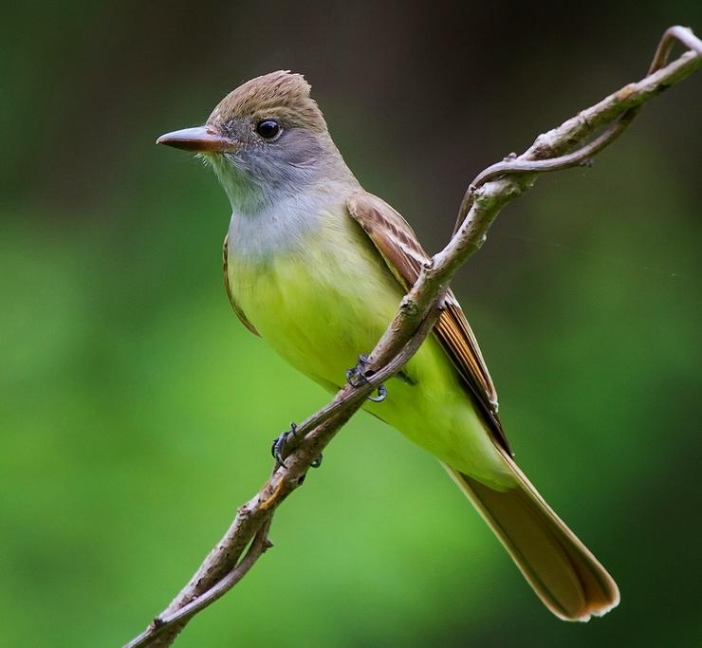
Great-crested Flycatcher GCFL
Week 3
Song:
The most characteristic and frequent call is a loud, penetrating whee-eep whistle that rises quickly and ends abruptly.
http://www.allaboutbirds.org/guide/Great_crested_flycatcher/sounds
Habitat:
Great Crested Flycatchers live in woodlots and open woodland, particularly among deciduous trees.
Great Crested Flycatchers are sit-and-wait predators, flying from perches high in the forest canopy after large insects, and then returning to the same or a nearby perch.
Field Marks:
Great Crested Flycatchers are reddish-brown above, with a brownish-gray head, gray throat and breast, and bright lemon-yellow belly. The brown upperparts are highlighted by rufous-orange flashes in the primaries and in the tail feathers.

Slide 15
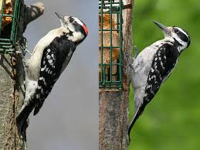
Downy Woodpecker DOWO
Week 3
Song:
Downy Woodpeckers make lots of noise, both with their shrill whinnying call and by drumming on trees.
http://www.allaboutbirds.org/guide/downy_woodpecker/sounds
Habitat:
Downy Woodpeckers can be found in open woodlands, particularly among deciduous trees, and brushy or weedy edges. They’re also at home in orchards, city parks, backyards and vacant lots.
They hitch around tree limbs and trunks or drop into tall weeds to feed on galls. They move more acrobatically than larger woodpeckers.
Field Marks:
The black upperparts are checked with white on the wings, the head is boldly striped, and the back has a broad white stripe down the center. Males have a small red patch on the back of the head. The outer tail feathers are typically white with a few black spots.

Slide 16
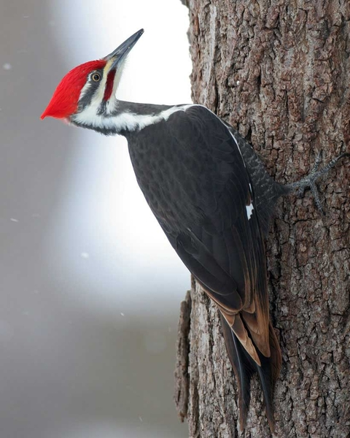
Pileated Woodpecker PIWO
Week 3
Song:
They are loud birds with whinnying calls. They also drum on dead trees in a deep, slow, rolling pattern, and even the heavy chopping sound of foraging carries well.
Loud and sharp call delivered at irregular speed: cuk cuk...cuk...cuk...cuk
http://www.allaboutbirds.org/guide/Pileated_Woodpecker/sounds
Habitat:
Pileated Woodpeckers are forest birds that require large, standing dead trees and downed wood. Forests can be evergreen, deciduous, or mixed.
Pileated Woodpeckers drill distinctive rectangular-shaped holes in rotten wood to get at carpenter ants and other insects.
Field Marks:
Pileated Woodpeckers are mostly black with white stripes on the face and neck and a flaming-red crest. Males have a red stripe on the cheek. In flight, the bird reveals extensive white underwings. It’s nearly the size of a crow

Slide 17
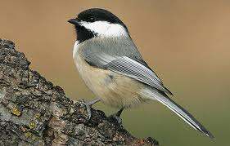
Black-capped Chickadee BCCH
Week 3
Song:
the song is a simple, pure 2 or 3-note whistled fee-bee or hey, sweetie. Or can sound like chickadee-dee-dee.
http://www.allaboutbirds.org/guide/Black-capped_Chickadee/sounds
Habitat:
Chickadees may be found in any habitat that has trees or woody shrubs, from forests and woodlots to residential neighborhoods and parks, and sometimes weedy fields and cattail marshes.
They frequently nest in birch or alder trees.
They are acrobatic and associate in flocks.
Field Marks:
The chickadee’s black cap and bib; white cheeks; gray back, wings, and tail; and whitish underside with buffy sides are distinctive.
A bird almost universally considered “cute” thanks to its oversized round head, tiny body, and curiosity about everything.

Slide 18
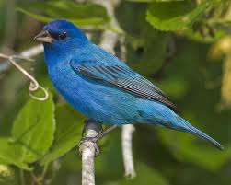
Indigo Bunting INBU
Week 4
Song:
Male Indigo Buntings whistle a bright, lively song of sharp, clear, high-pitched notes that lasts about 2 seconds.
Notes or phrases are often repeated in pairs: "what! what! where? where? see it! see it!"
http://www.allaboutbirds.org/guide/Indigo_Bunting/sounds
Habitat:
Look for Indigo Buntings in weedy and brushy areas, especially where fields meet forests. They love edges, hedgerows, overgrown patches, and brushy roadsides.
When not singing from the tallest perches in the area, they can often be seen foraging among seed-laden shrubs and grasses.
Field Marks:
A breeding male Indigo Bunting is blue all over, with slightly richer blue on his head and a shiny, silver-gray bill. Females are basically brown, with faint streaking on the breast, a whitish throat, with a touch of blue on the wings, tail, or rump.

Slide 19
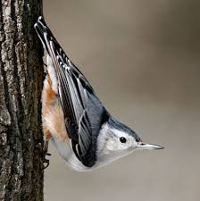
White-breasted Nuthatch WBNU
Week 4
Song:
They sing a rapid, nasal, fairly low-pitched wha-wha-wha that lasts 2-3 seconds.
http://www.allaboutbirds.org/guide/White-breasted_Nuthatch/sounds
Habitat:
White-breasted Nuthatches are birds of mature woods and woodland edges. They’re particularly associated with deciduous trees.
They are agile birds that creep along trunks and large branches, probing into bark furrows with their straight, pointed bills. Like other nuthatches, they often turn sideways and upside down on vertical surfaces as they forage.
Field Marks:
White-breasted Nuthatches are gray-blue on the back, with a frosty white face and underparts. The black or gray cap and neck frame the face and make it look like this bird is wearing a hood. The lower belly and under the tail are often chestnut.

Slide 20
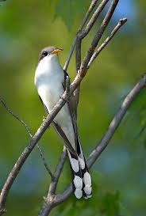
Yellow-billed Cuckoo YBCU
Week 4
Song:
Male Yellow-Billed Cuckoos make a distinctive series of hollow, wooden-sounding ka-ka-ka-ka-ka-kow-kow-kowlp-kowlp-kowlp-kowlp syllables. The whole series is quite slow and gets slower toward the end
http://www.allaboutbirds.org/guide/yellow-billed_cuckoo/sounds
Habitat:
They live mainly among the canopies of deciduous trees; look for them in woodland patches with gaps and clearings.
Yellow-billed Cuckoos forage slowly and methodically in treetops for large, hairy caterpillars—their slow approach can make them hard to find.
Field Marks:
Yellow-billed Cuckoos are brown above and clean whitish below. They have a blackish mask across the face and a yellow eyering. In flight, the outer part of the wings flash rufous. From below, the tail has wide white bands and narrower black ones. The bill is mostly yellow.

Slide 21
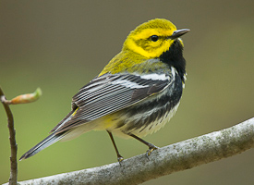
Black-throated Green Warbler BTNW
Week 4
Song:
The male Black-throated Green Warbler tends to sing his "zee-zee-zee-zoo-zee" song near the middle of his territory, largely in the beginning of the breeding season
http://www.allaboutbirds.org/guide/Black-throated_Green_Warbler/sounds
Habitat:
An abundant breeder of the northeastern coniferous forests, the Black-throated Green Warbler is easy to recognize by sight and sound.
Gleans from small branches; sometimes hovers and picks prey from leaves and branches.
Field Marks:
Yellow face, with olive-green crown and ear patches. Green mantle. Two white bars on each wing. Black chin, throat, and breast, with bold streaks on the flanks.

Slide 22
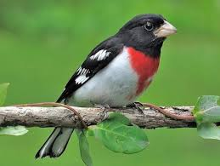
Rose-breasted Grosbeak RBGR
Week 4
Song:
Both males and females sing a rich, sweetly whistled song. The pattern is similar to an American Robin’s song. Most people describe the grosbeak’s song as sweeter and more melodious than a robin’s song.
http://www.allaboutbirds.org/guide/rose-breasted_grosbeak/sounds
Habitat:
Rose-breasted Grosbeaks breed in eastern forests; you can find them among both deciduous trees and conifers. They are most common in regenerating woodlands and often concentrate along forest edges and in parks.
They are also frequent visitors to backyard bird feeders, where they eat sunflower seeds with abandon.
Field Marks:
Adult males are black-and-white birds with a brilliant red chevron extending from the black throat down the middle of the breast. Females and immature birds are brown and heavily streaked, with a bold whitish stripe over the eye. Males flash pink-red under the wings; females flash yellowish.

Slide 23
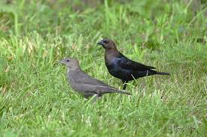
Brown-headed Cowbird BHCO
Song:
The male's song consists of several faint bubbling sounds followed by a long squeak, bublo-seeleeee.
http://www.allaboutbirds.org/guide/Brown-headed_Cowbird/sounds
Habitat:
Brown-headed Cowbirds are found in open habitats, such as fields, pastures, meadows, forest edges, and lawns. When not feeding on the ground, they often perch high on prominent tree branches.
Field Marks:
Male Brown-headed Cowbirds have glossy black plumage and a brown head that often looks black in poor lighting or at distance. Female Brown-headed Cowbirds are plain brown birds, lightest on the head and underparts, with fine streaking on the belly.
NOTE: Cowbirds are parasitic upon other birds in that the females do not build their own nest. They lay their eggs in other birds’ nests and leave the raising of young to the other female. Cowbird babies are born larger and outcompete the host’s own young. These grassland birds have moved in from the mid-west as we have cleared woodland habitats in the east.

